Slide 1

Customer Retention
E-retail factors for customer activation and retention: A case study from Indian e-commerce customers
Presented By :
ARGHA MAITI

Slide 2

Introduction
Customer satisfaction has emerged as one of the most important factors that guarantee the success of online store; it has been posited as a key stimulant of purchase, repurchase intentions and customer loyalty.
A comprehensive review of the literature, theories and models have been carried out to propose the models for customer activation and customer retention.
Five major factors that contributed to the success of an e-commerce store have been identified as: service quality, system quality, information quality, trust and net benefit.
The research furthermore investigated the factors that influence the online customers repeat purchase intention. The combination of both utilitarian value and hedonistic values are needed to affect the repeat purchase intention (loyalty) positively. The data is collected from the Indian online shoppers. Results indicate the e-retail success factors, which are very much critical for customer satisfaction.

Slide 3
Data source
The data is collected from the Indian online shoppers. Results indicate the e-retail success factors, which are very much critical for customer satisfaction.

Slide 4

Customer Retention?
Customer retention is the collection of activities a business uses to increase the number of repeat customers and to increase the profitability of each existing customer.
Customer retention strategies enable us to both provide and extract more value from our existing customer base. We want to ensure the customers we worked so hard to acquire stay with us, have a great customer experience, and continue to get value from our products.

Slide 5
Five major factors
Service quality,
System quality,
Information quality,
Trust
Net benefit

Slide 6
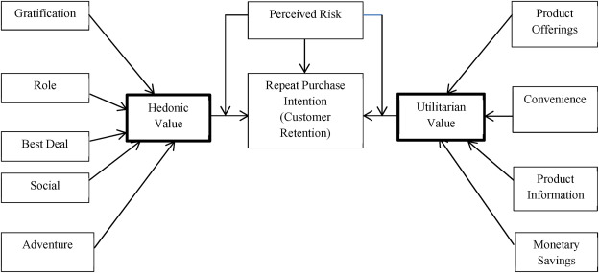
Diagrammatic Representation of Customer Retention

Slide 7
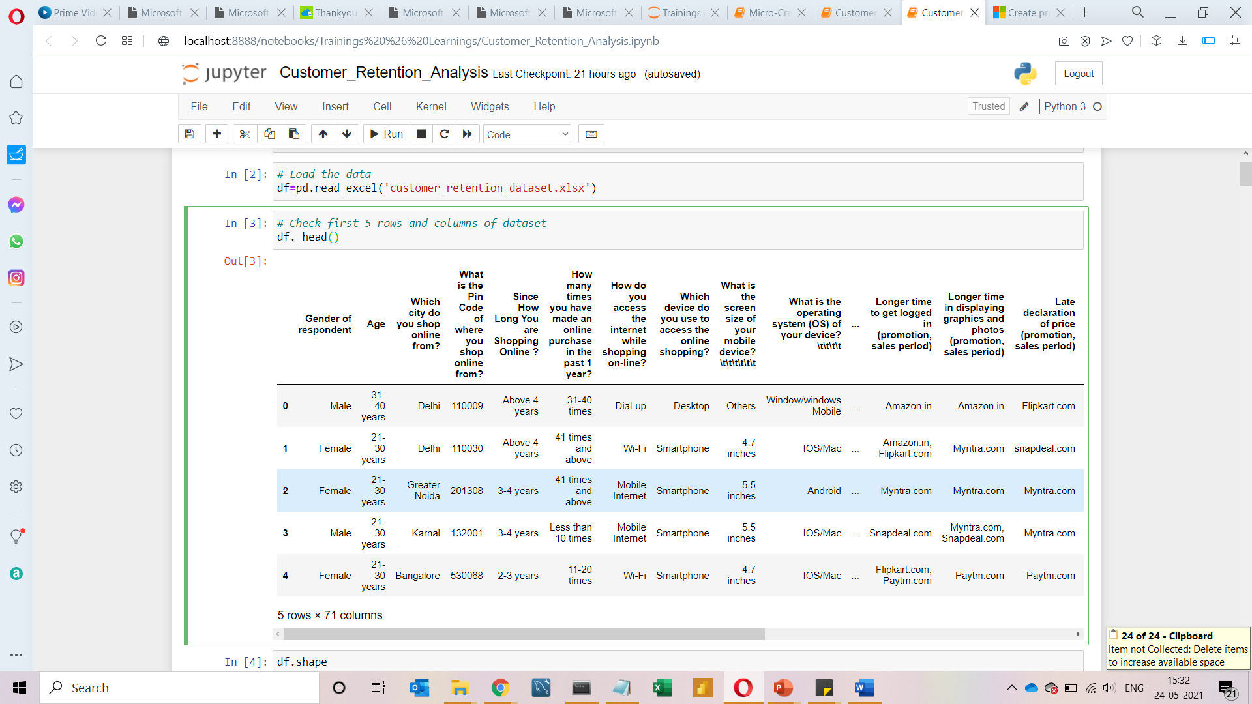
Data Set Details
df.shape
(269,71)
This Dataset is provided by Flip Robo Technologies xlsx format.
This Data set contains 267 columns and 71 rows.
There are no null values present in this data.

Slide 8
Problem Statement
Customer satisfaction is ecommerce platform is a key parameter for customer retention.
Success of any online shopping store has been defined in a few key metrices like service quality, system quality, information quality, trust & benefit.
For this we have collected a dataset and want to know what are factors to that are very crucial for customer feedback while purchasing a product online
We have done some data analysis to provide valuable insights that helps understand the customer better.

Slide 9

Hardware and Software Requirements and Tools Used:
For this dataset, the Hardware is used Windows as operating system, a stable internet connection, and the software used are mainly Jupyter notebook to do my python programming and analysis.
I received data in xlsx format, I had used few libraries on Jupyter Notebook for this project. The Libraries are:
Pandas- a library which is used to read the data, visualization, and analysis of data.
NumPy- used for working with array and various mathematical techniques.
Seaborn- visualization tool for plotting different types of plot.
Matplotlib- It provides an object-oriented API for embedding plots into applications.

Slide 10
Key Metrics for success in solving problem under consideration
Gender of the respondent
What browser do you run on your device to access the website?
Which device do you use to access the online shopping?
Which of the Indian online retailer would you recommend to a friend?
Quickness to complete purchase
Speedy order delivery
Presence of online assistance through multi-channel
Getting value for money spent
Return and replacement policy of the e-tailer is important for purchase decision
Shopping online is convenient and flexible
Convenient Payment methods
User friendly Interface of the website

Slide 11

EDA Process And Visualization

Slide 12
Check the name of columns df.columns
Index(['Gender', 'Age', 'city', 'Pin Code', 'How Long You are Shopping Online', 'How many times in the past 1 year', 'How do you access the internet’, 'device', 'screen size', 'operating system', 'browser', 'channel’, 'After first visit', 'How much times', 'payment Option’, 'How frequently do you abandon', 'Why did you abandon’, 'content on the website', 'similar product', 'Complete information’, 'relevant information', 'Ease of navigation’, 'Loading and processing speed', 'User friendly’, 'Convenient Payment methods', 'Trust that the online retail store’, 'Empathy towards the customers', 'privacy of the customer’, 'Responsiveness and availability', 'monetary benefit and discounts’, 'Enjoyment is derived from shopping online’, 'Shopping online is convenient and flexible’, ‘Return and replacement policy', 'Gaining access to loyalty', 'quality Information on the website', 'User derive satisfaction’, 'Net Benefit', 'User satisfaction cannot exist without trust’, 'Offering a wide variety’, 'Provision of complete and relevant product information’, 'Monetary savings’, 'The Convenience of patronizing the online retailer’, 'sense of adventure', 'enhances your social status’, 'gratification shopping on your favorite e-tailer', 'Shopping on the website helps you fulfill certain roles’, 'Getting value for money spent', 'you have shopped from’, 'Easy to use website or application’, 'Visual appealing web-page layout', 'Wild variety of product on offer’, 'Complete description information of products', 'Fast loading website speed of website and application', 'Reliability of the website or application’, 'Quickness to complete purchase', 'Availability of several payment options', 'Speedy order delivery ','Privacy of customers’ information’, 'Security of customer financial information', 'Perceived Trustworthiness’, 'Presence of online assistance through multi-channel’, 'Longer time to get logged in’, 'Longer time in displaying graphics and photos’, 'Late declaration of price', 'Longer page loading time’, 'Limited mode of payment on most products', 'Longer delivery period’, 'Change in website/Application design’, 'Frequent disruption when moving from one page to another’, 'Website is as efficient as before',
'Which of the Indian online retailer would you recommend to a friend'],
dtype='object')
df.columns

Slide 13
Renaming columns into a right form for easy & better understanding
df.columns=['Gender', 'Age', 'city', 'Pin Code', 'How Long You are Shopping Online', 'How many times in the past 1 year', 'How do you access the internet', 'device', 'screen size', 'operating system', 'browser', 'channel', 'After first visit', 'How much times', 'payment Option', 'How frequently do you abandon', 'Why did you abandon', 'content on the website', 'similar product', 'Complete information', 'relevant information', 'Ease of navigation', 'Loading and processing speed', 'User friendly', 'Convenient Payment methods', 'Trust that the online retail store', 'Empathy towards the customers', 'privacy of the customer', 'Responsiveness and availability', 'monetary benefit and discounts', 'Enjoyment is derived from shopping online', 'Shopping online is convenient and flexible', 'Return and replacement policy', 'Gaining access to loyalty', 'quality Information on the website', 'User derive satisfaction', 'Net Benefit', 'User satisfaction cannot exist without trust’, 'Offering a wide variety', 'Provision of complete and relevant product information', 'Monetary savings', 'The Convenience of patronizing the online retailer', 'sense of adventure', 'enhances your social status', 'gratification shopping on your favorite e-tailer’, 'Shopping on the website helps you fulfill certain roles', 'Getting value for money spent', 'you have shopped from', 'Easy to use website or application', 'Visual appealing web-page layout', 'Wild variety of product on offer', 'Complete description information of products', 'Fast loading website speed of website and application', 'Reliability of the website or application', 'Quickness to complete purchase', 'Availability of several payment options', 'Speedy order delivery ', 'Privacy of customers’ information', 'Security of customer financial information', 'Perceived Trustworthiness', 'Presence of online assistance through multi-channel', 'Longer time to get logged in', 'Longer time in displaying graphics and photos', 'Late declaration of price', 'Longer page loading time', 'Limited mode of payment on most products', 'Longer delivery period', 'Change in website/Application design', 'Frequent disruption when moving from one page to another', 'Website is as efficient as before', 'Which of the Indian online retailer would you recommend to a friend']

Slide 14
Exploring Categorical Columns
for column in df.columns:
if df[column].dtypes == object:
print(str(column) + ' : ' + str(df[column].unique()))
print(df[column].value_counts())
print(‘--------------------------------------------------------------------------------')
print('\n')

Slide 15
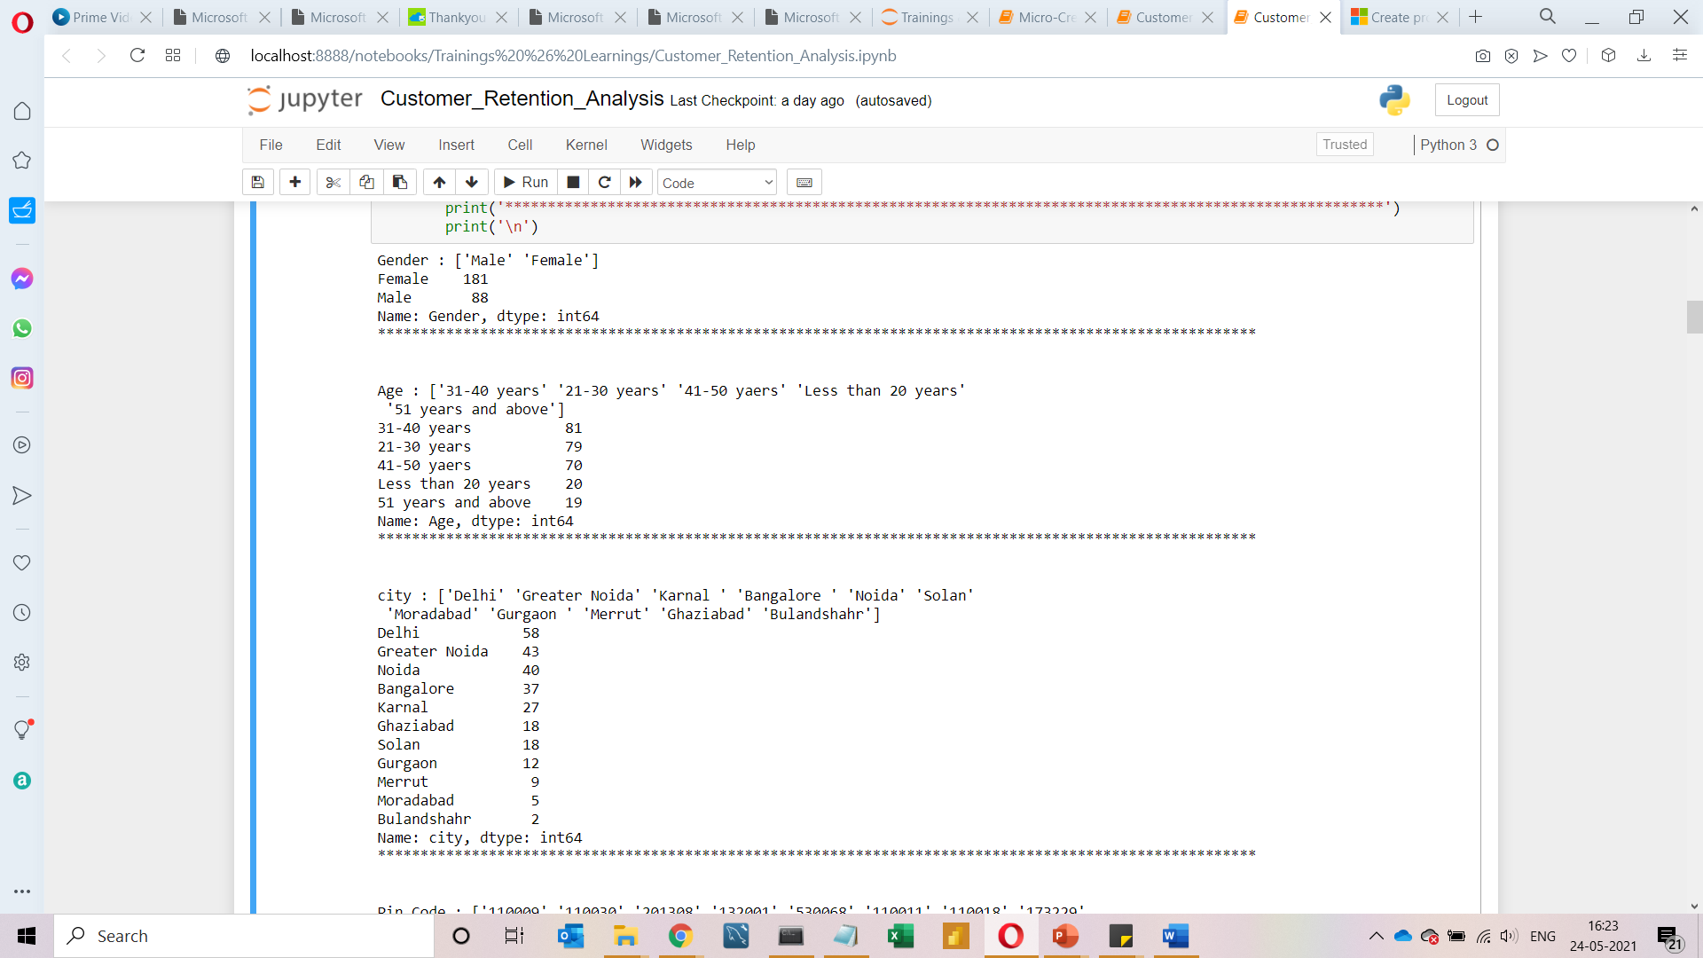
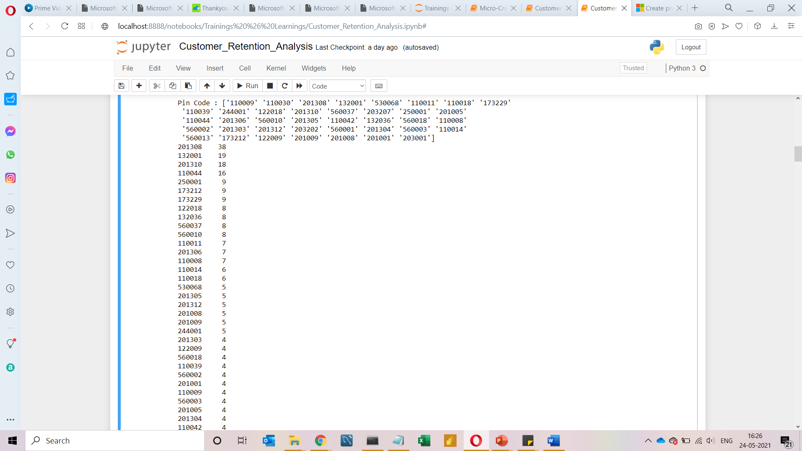
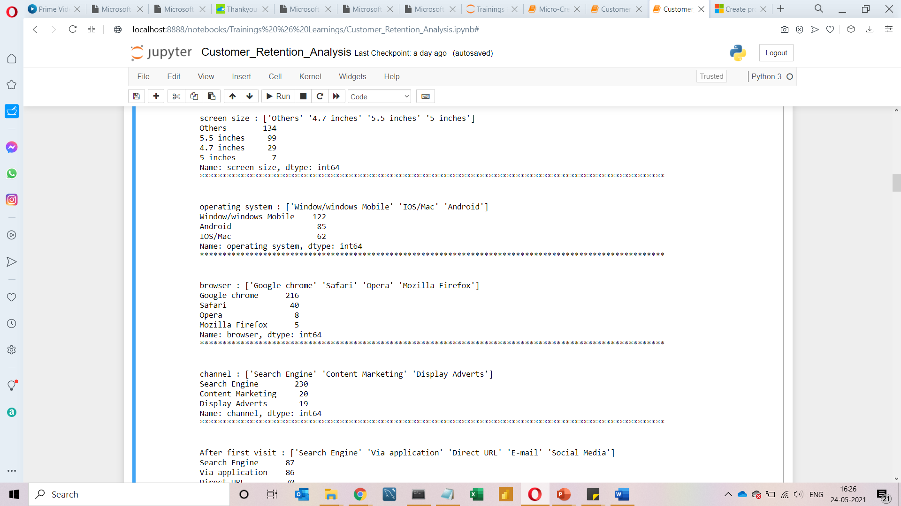

Slide 16
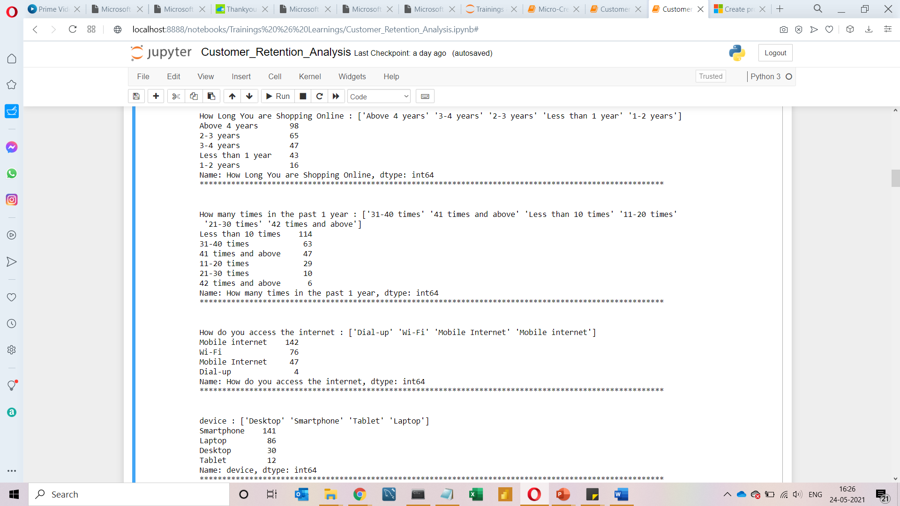
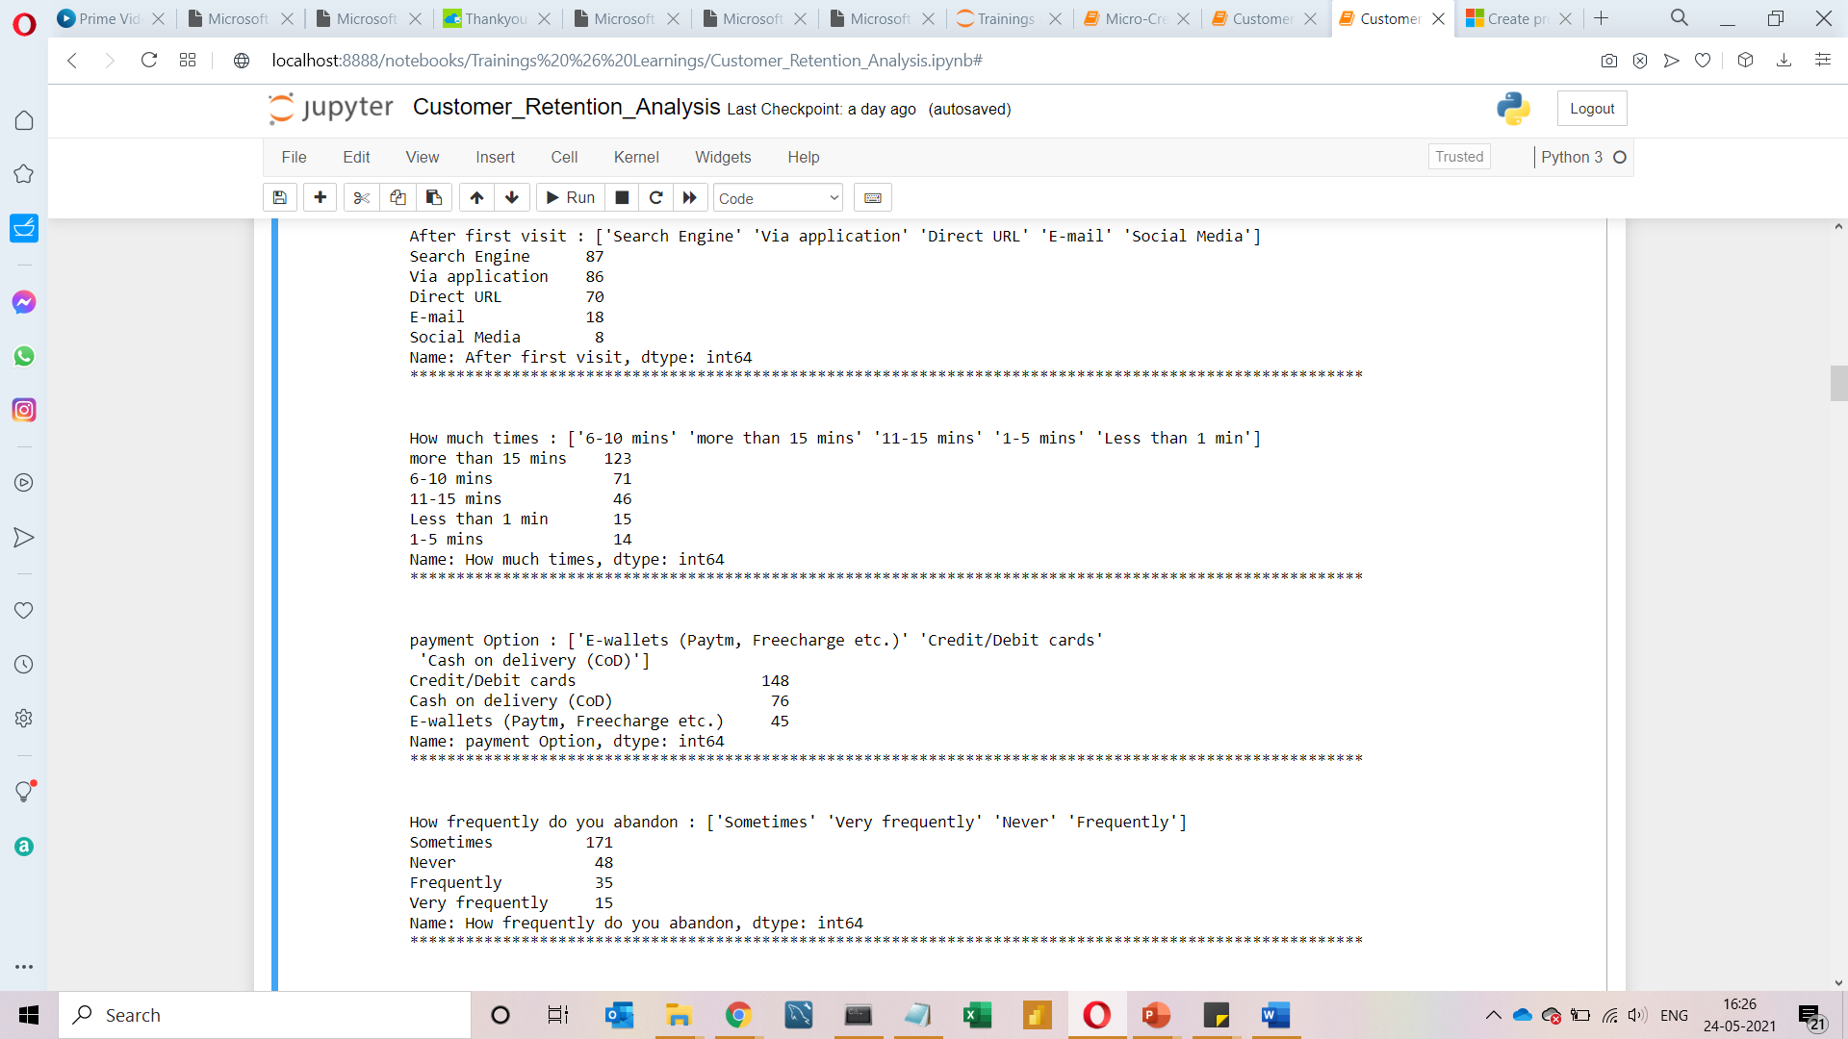

Slide 17
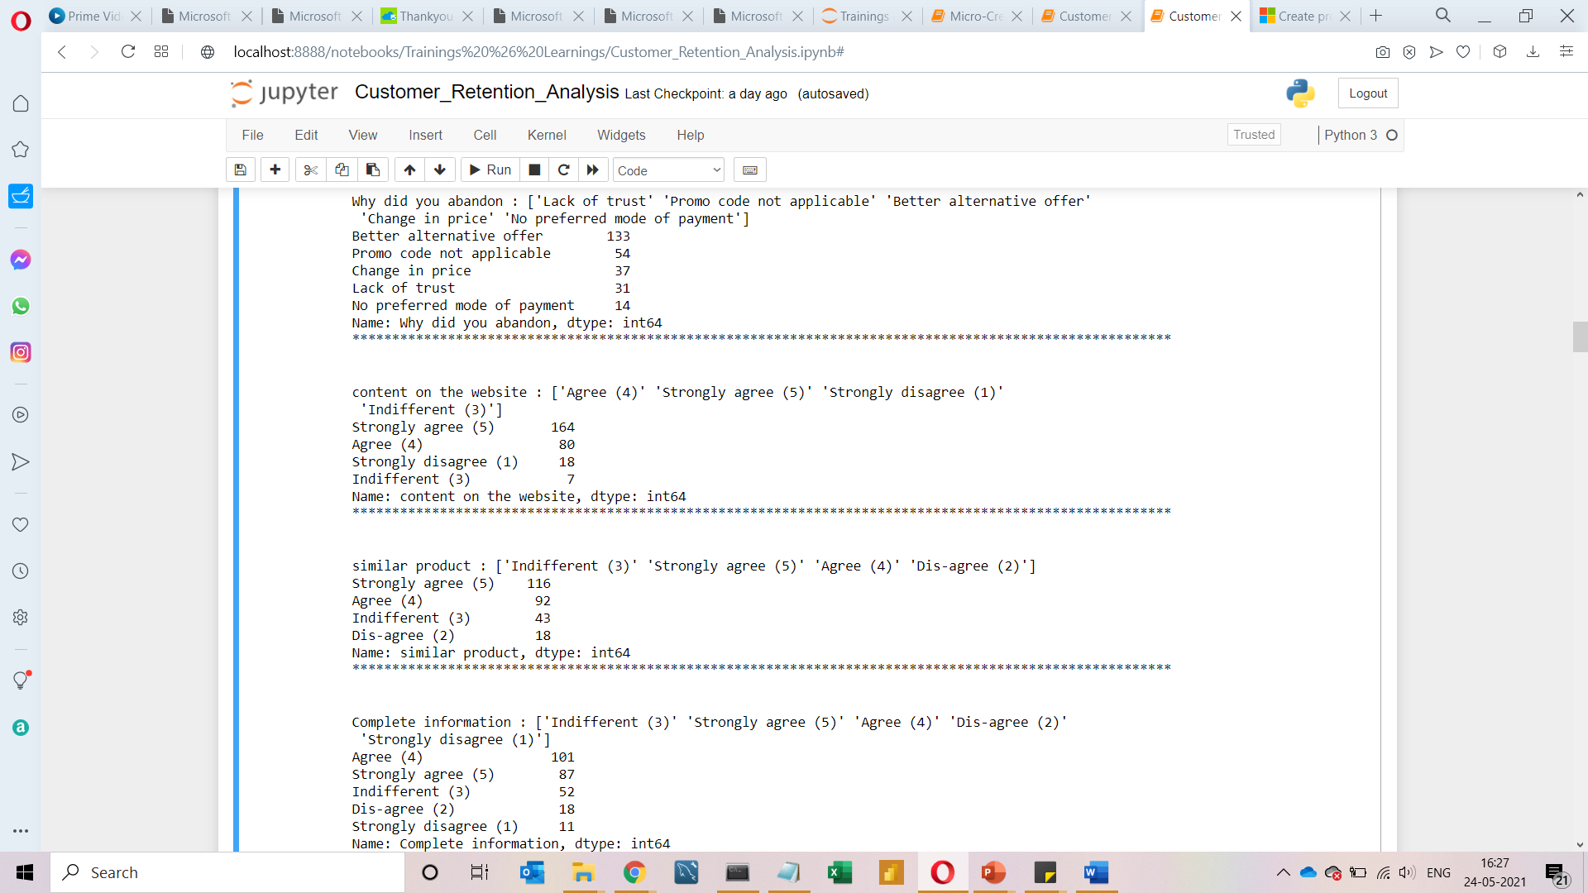
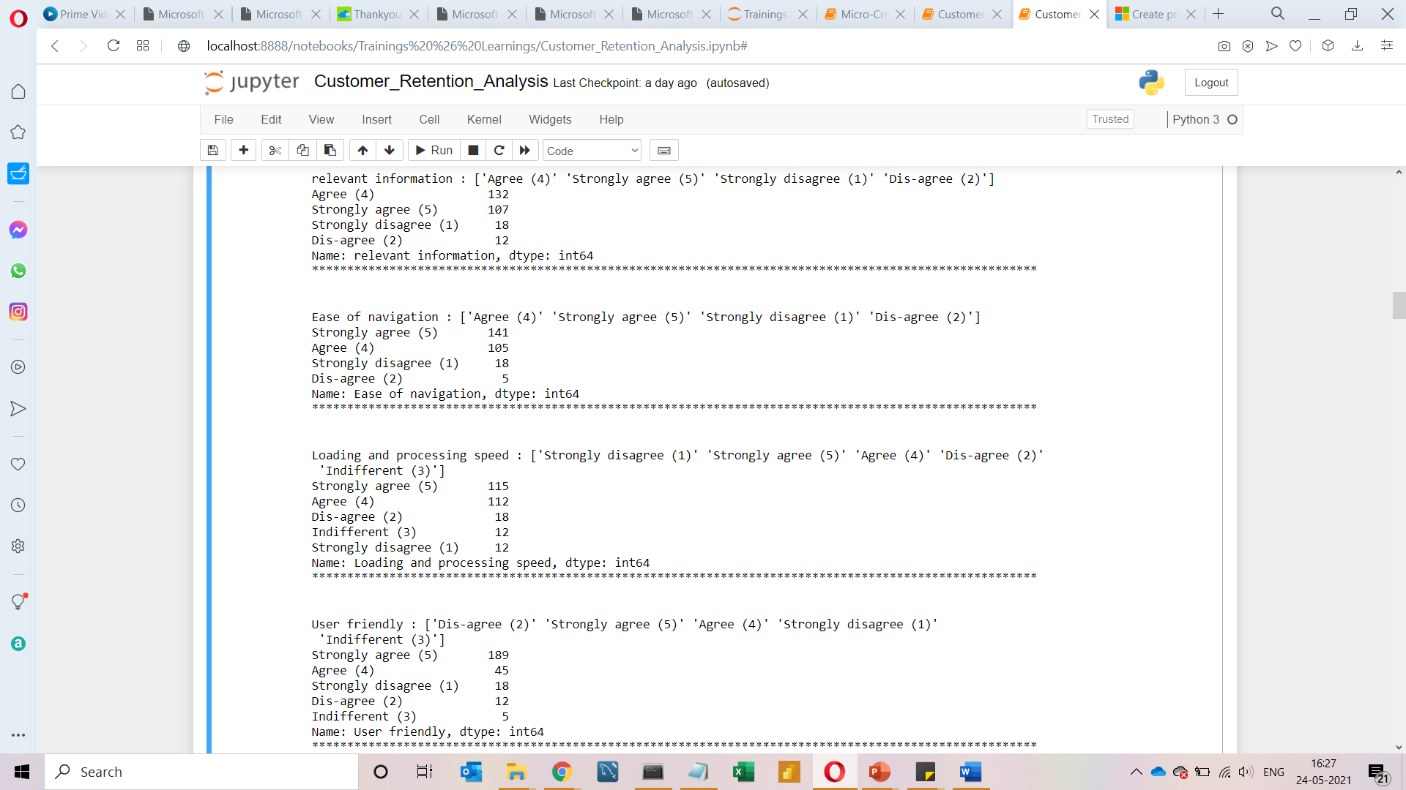

Slide 18
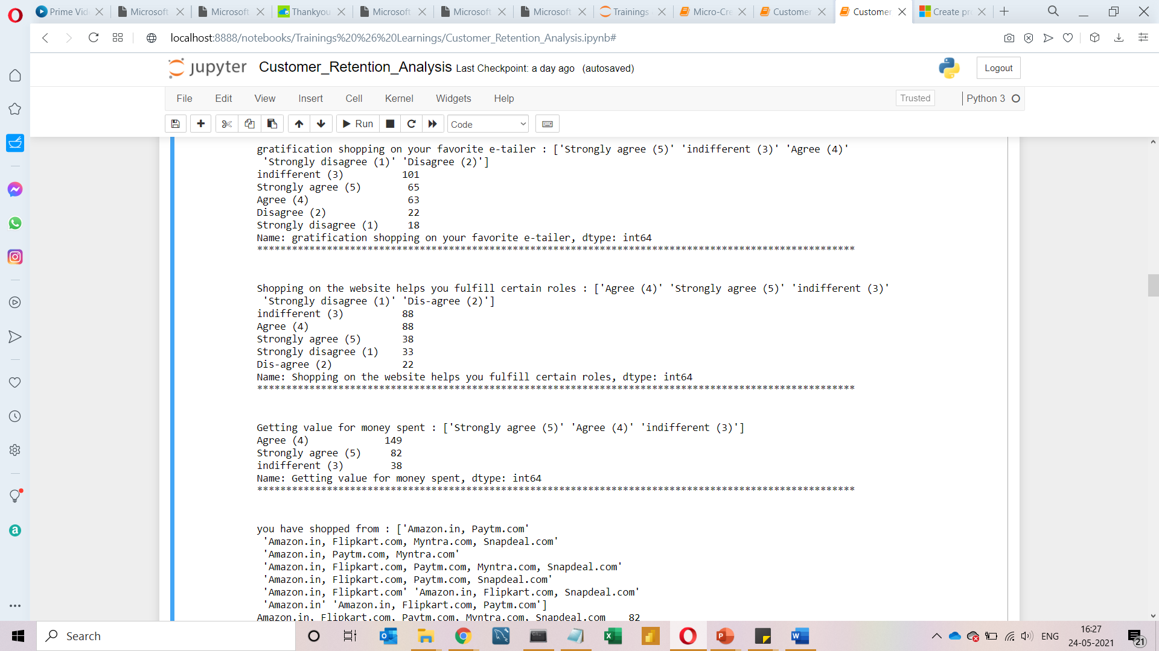
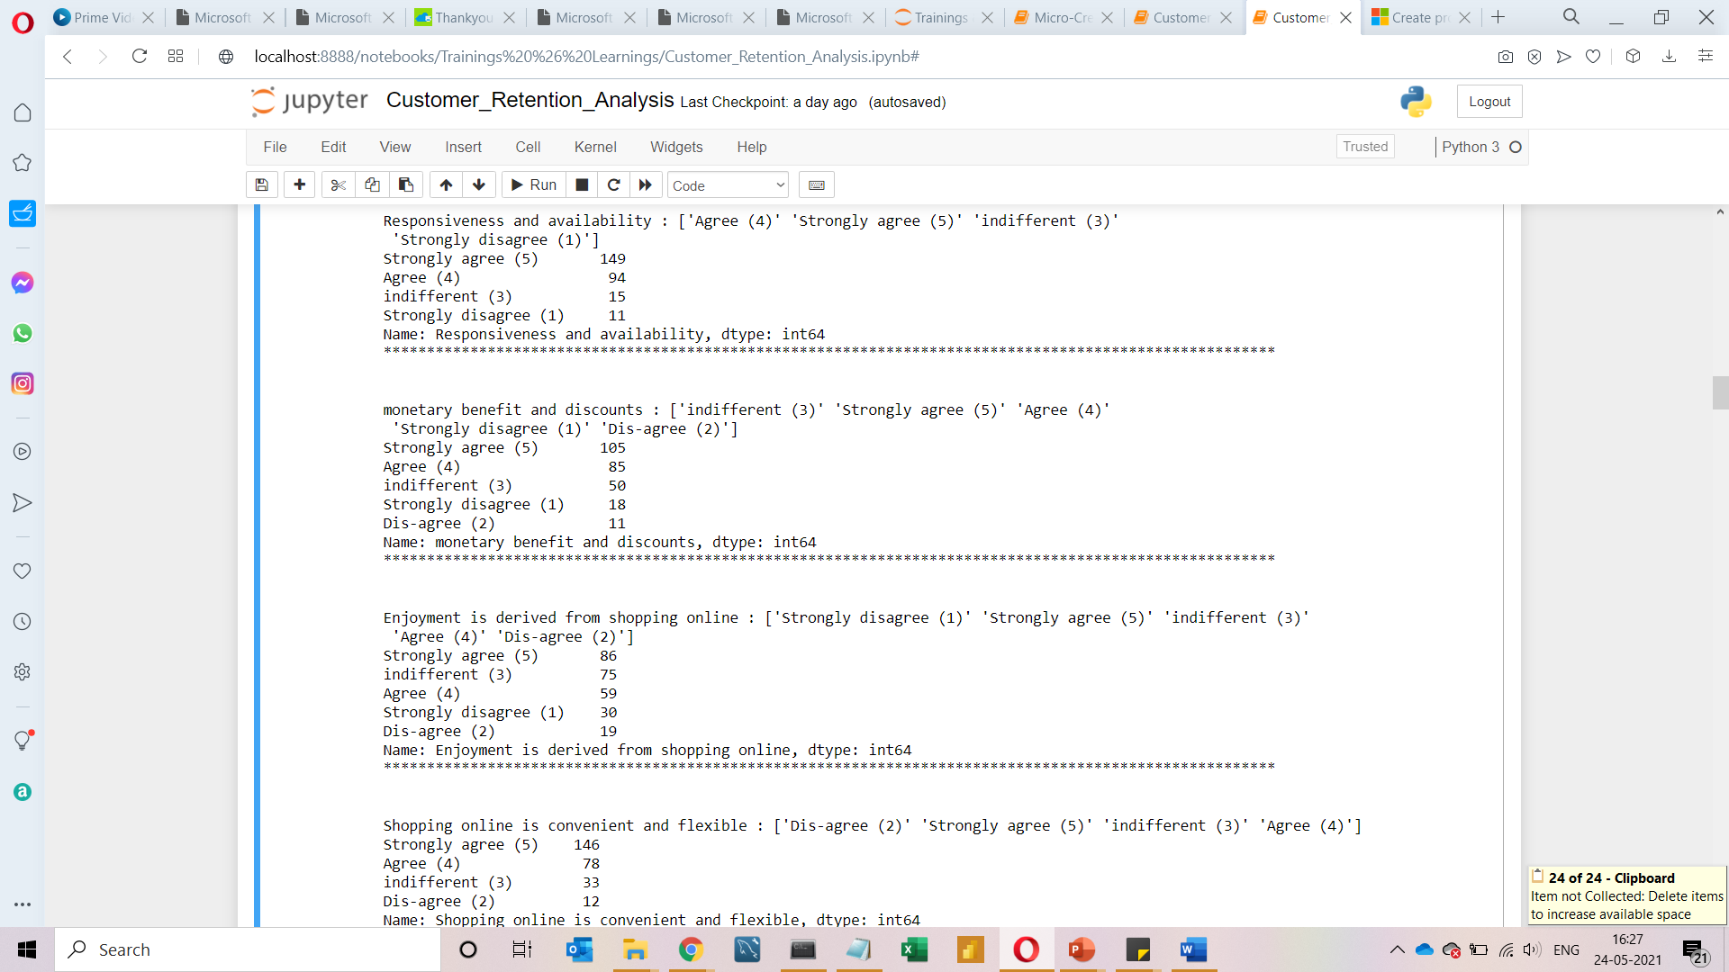

Slide 19
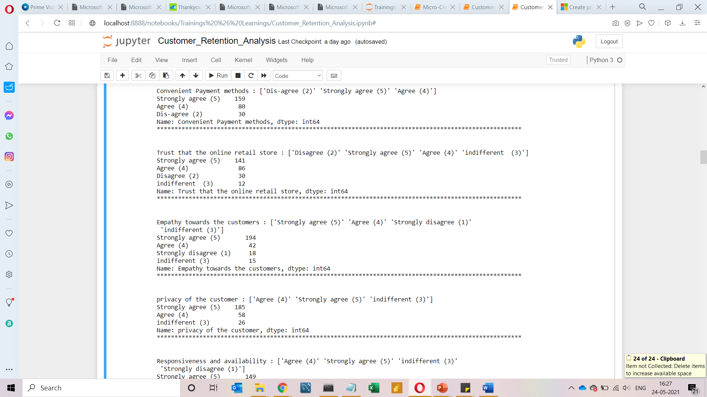
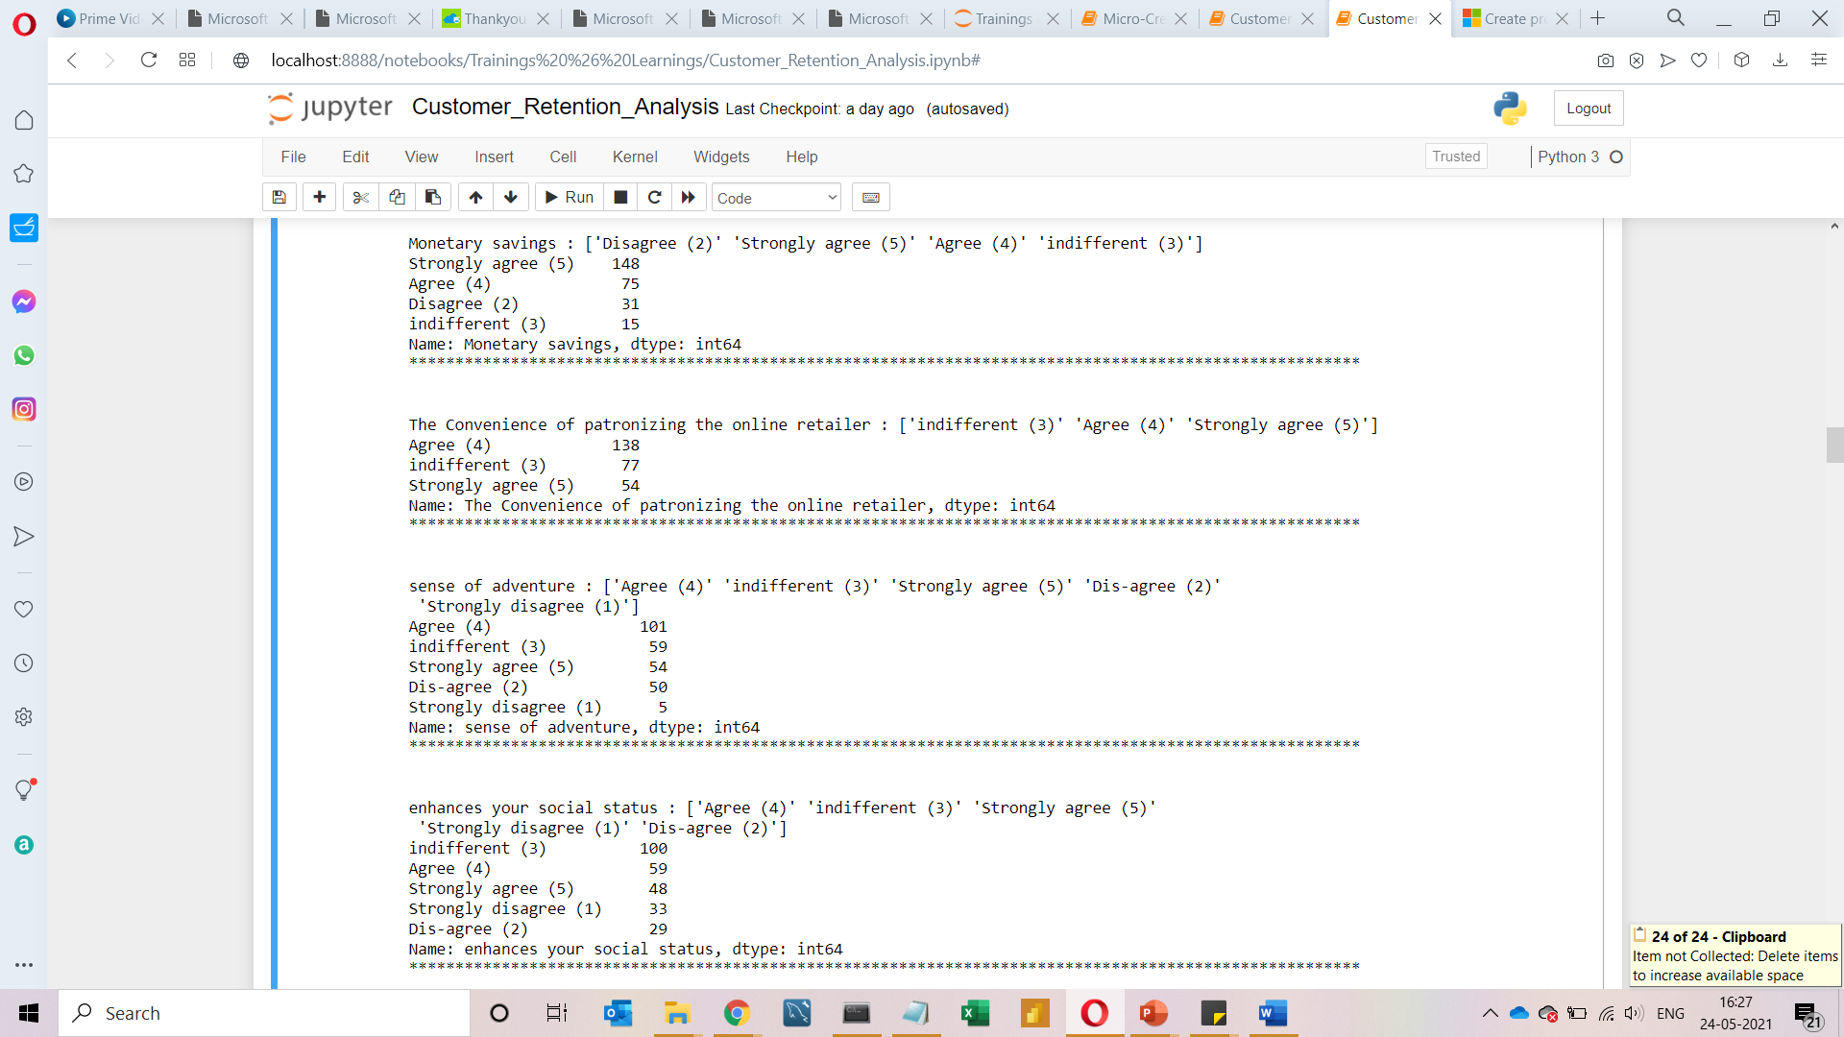

Slide 20
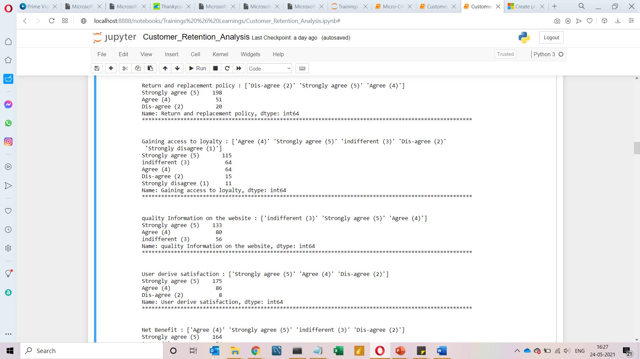
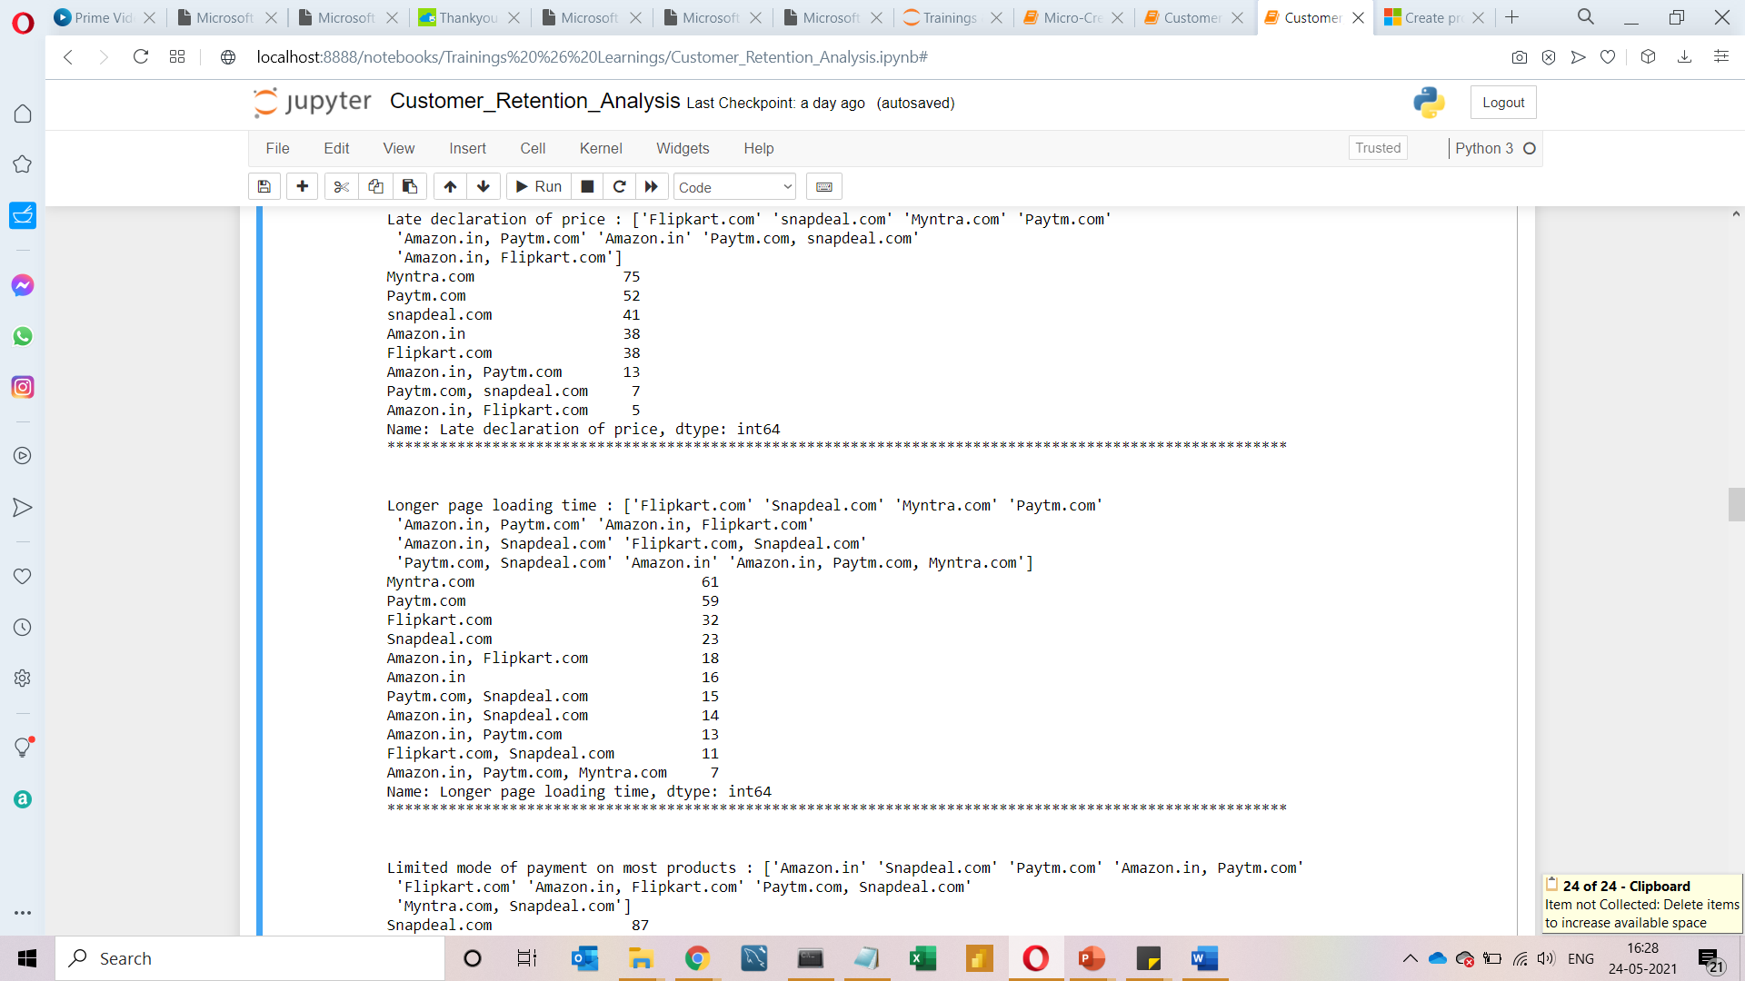

Slide 21
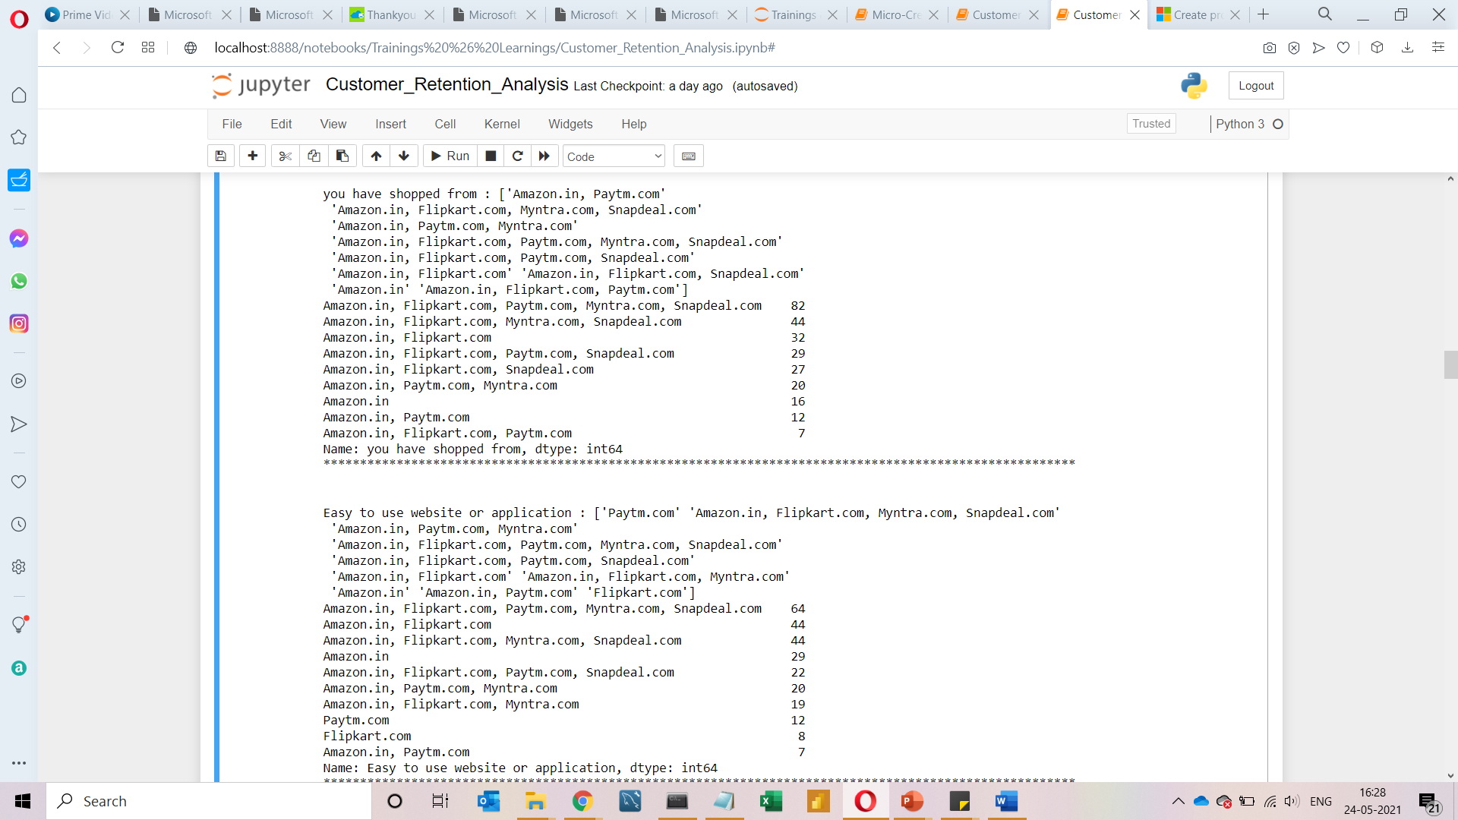
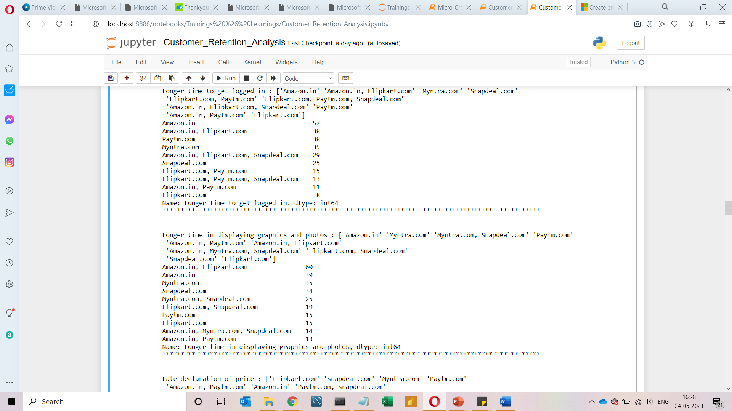

Slide 22
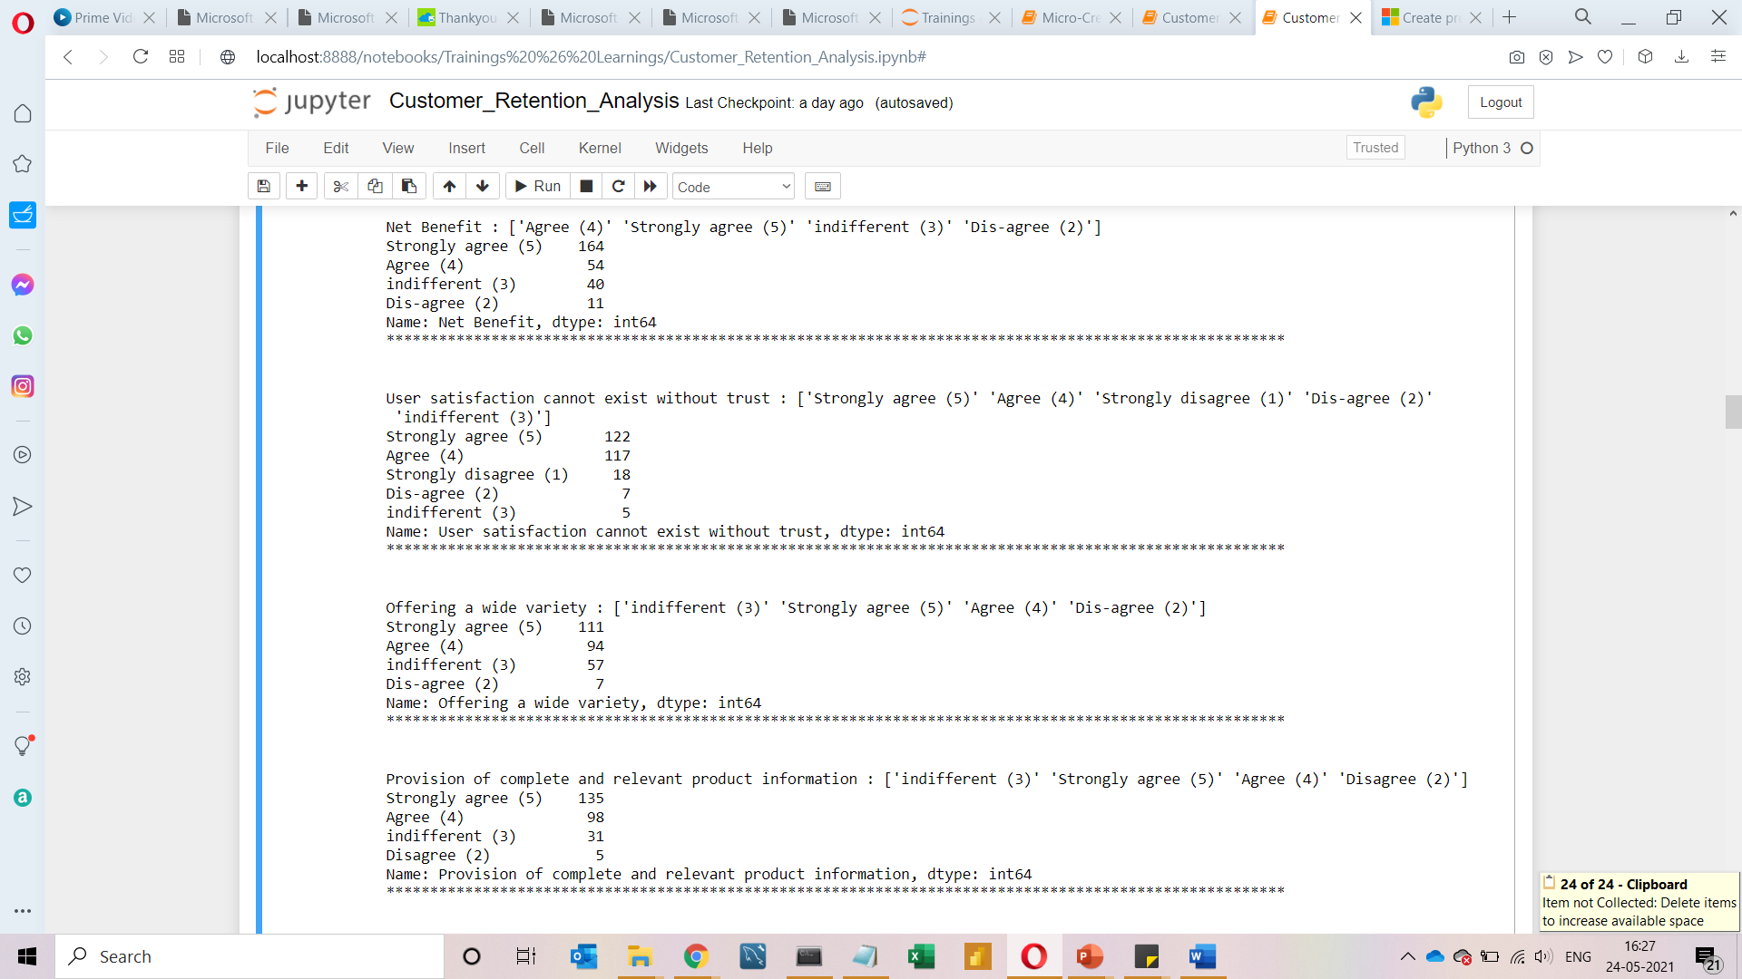
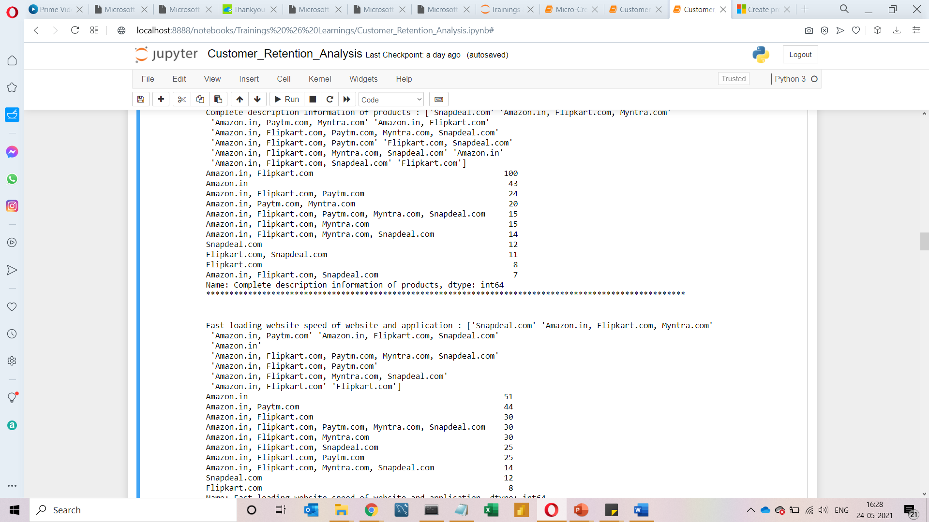

Slide 23
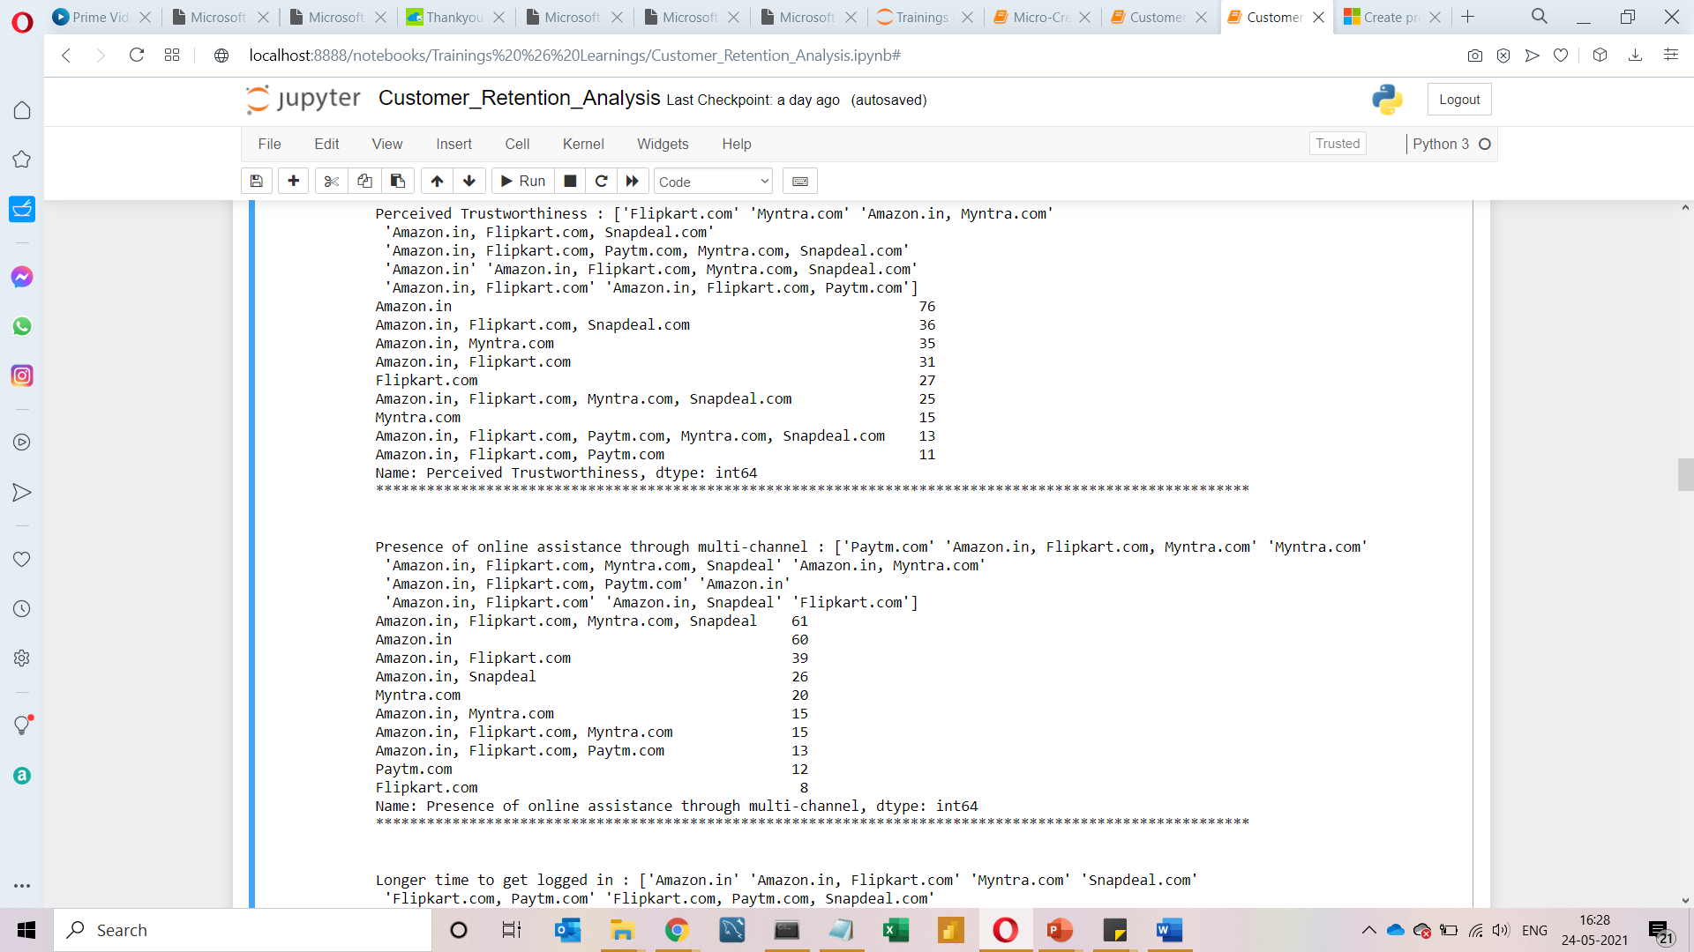
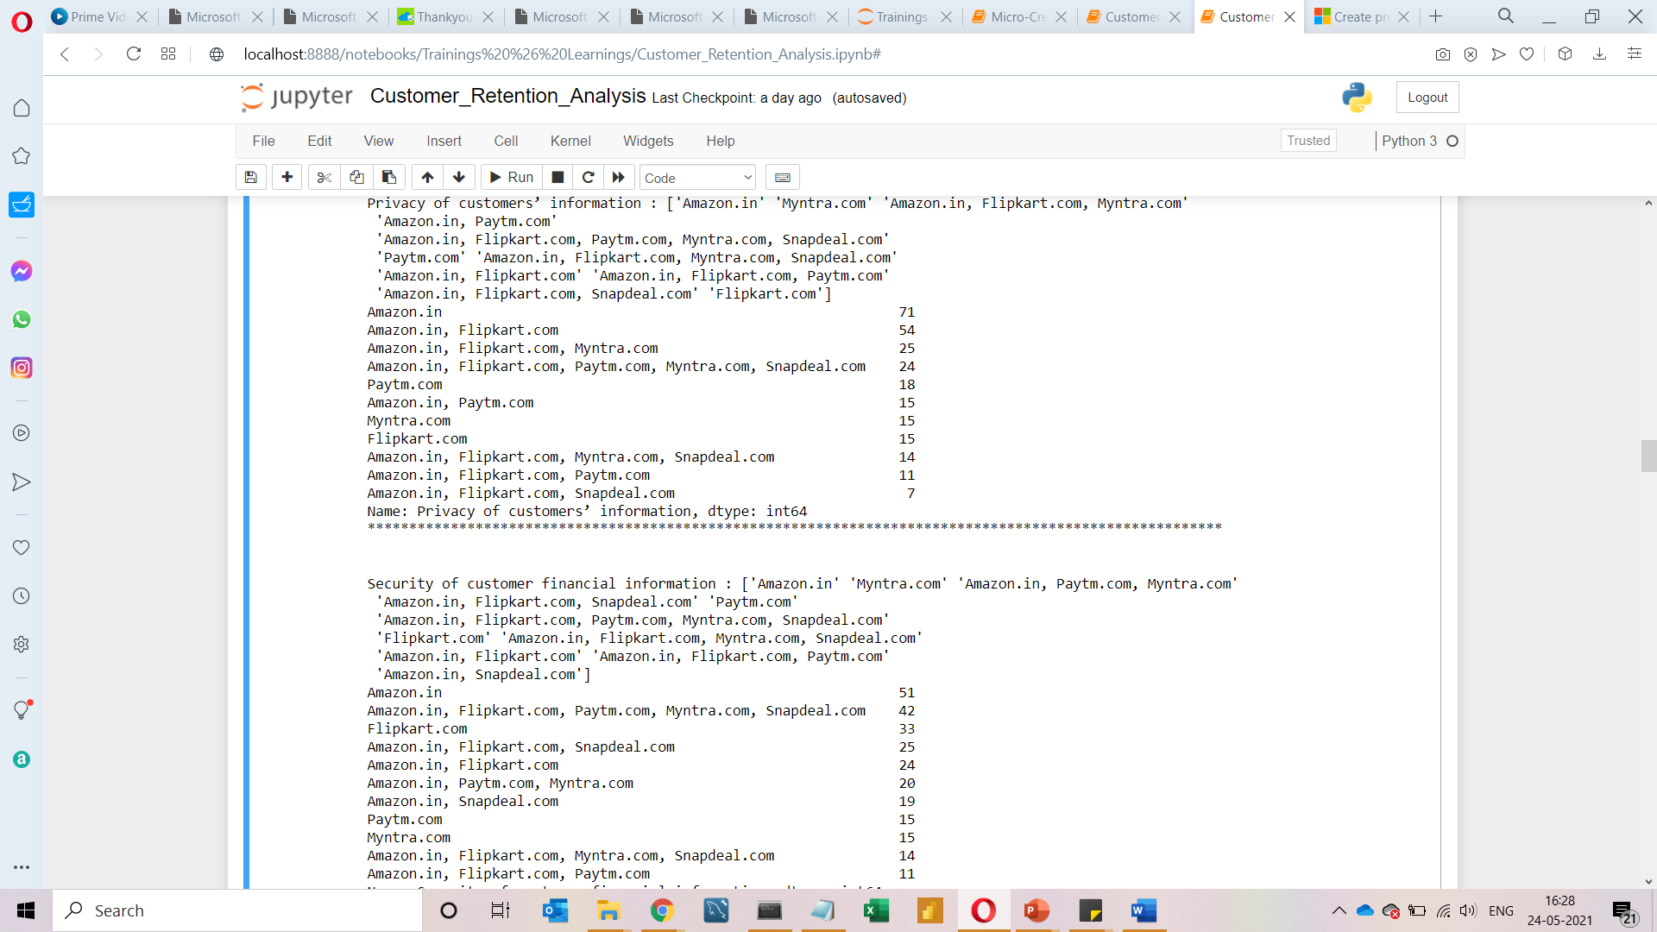

Slide 24
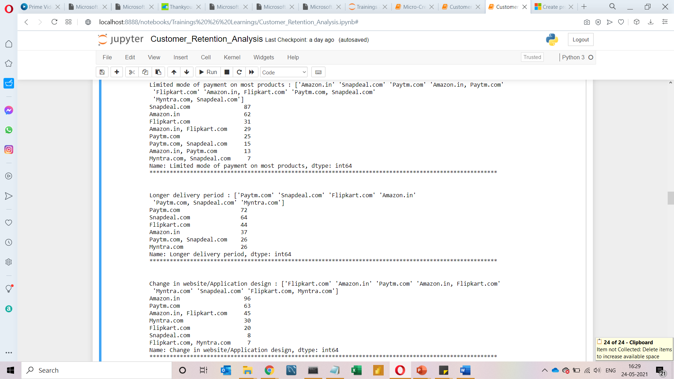
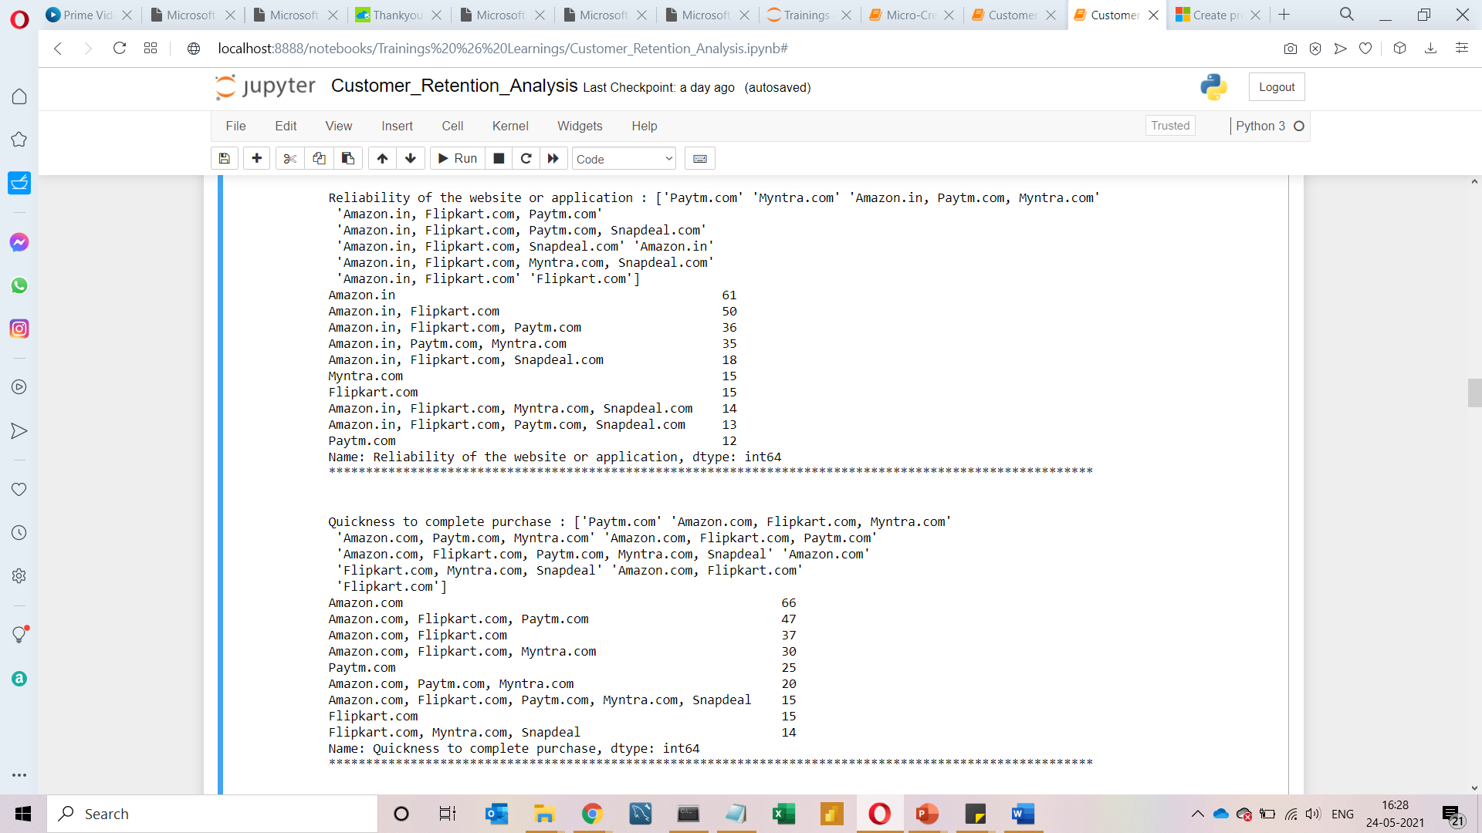

Slide 25
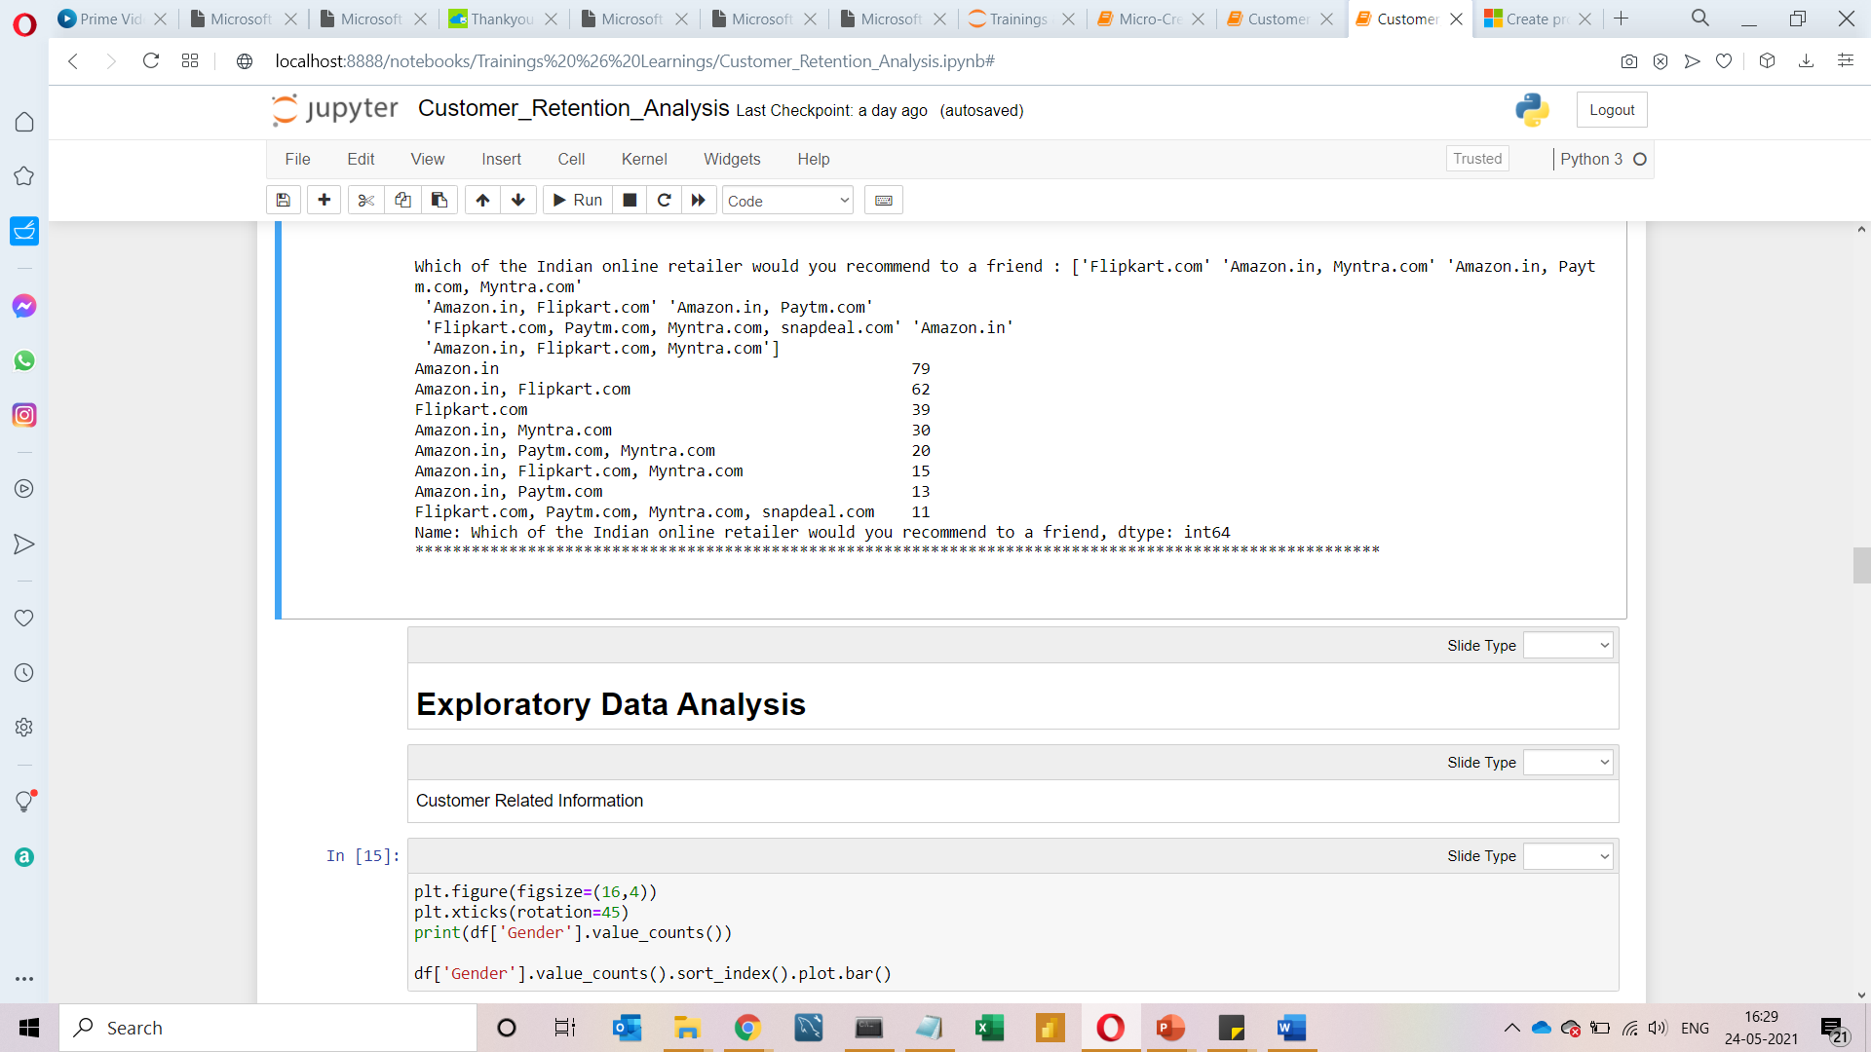
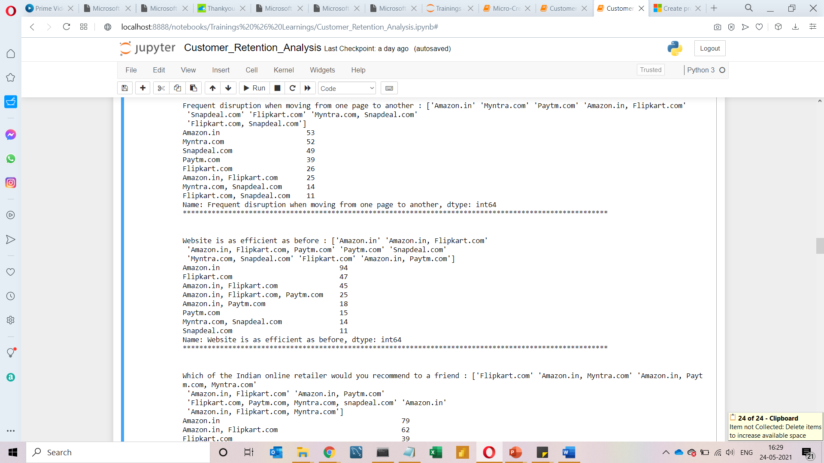
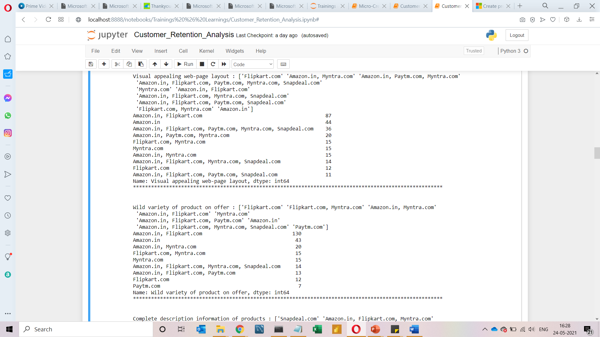

Slide 26

Visualization
Customer Retention

Slide 27
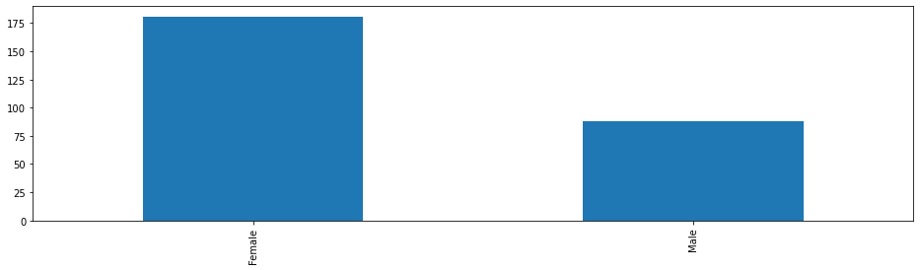
Customer Related Information
Female 181
Male 88
Name: Gender, dtype: int64
From the above analysis, it has been observed that around 70% of the customers are women

Slide 28
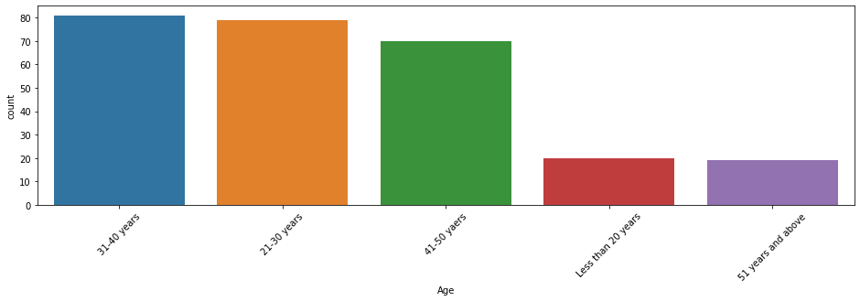
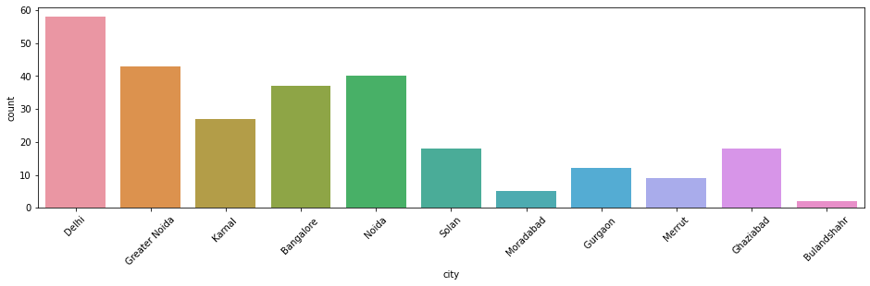
31-40 years 81
21-30 years 79
41-50 years 70
Less than 20 years 20
51 years and above 19
Name: Age, dtype: int64
Delhi 58
Greater Noida 43
Noida 40
Bangalore 37
Karnal 27
Solan 18
Ghaziabad 18
Gurgaon 12
Merrut 9
Moradabad 5
Bulandshahr 2
Name: city, dtype: int64

Slide 29
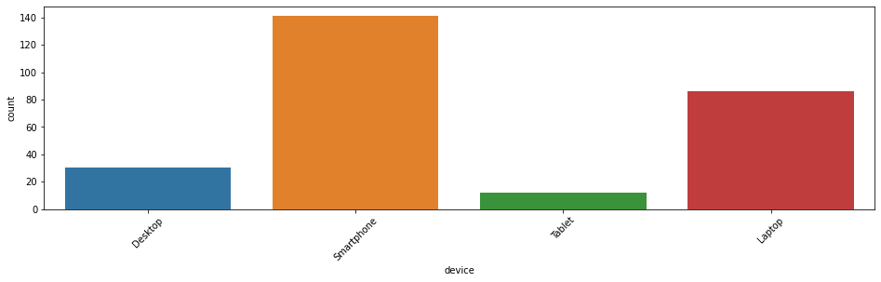
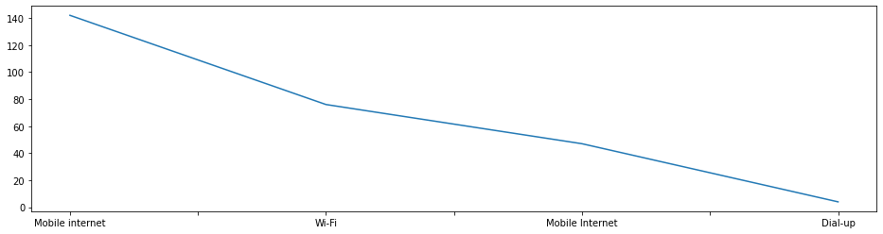
Mobile internet 142
Wi-Fi 76
Mobile Internet 47
Dial-up 4
Name: How do you access the internet, dtype: int64
Smartphone 141
Laptop 86
Desktop 30
Tablet 12
Name: device, dtype: int64

Slide 30
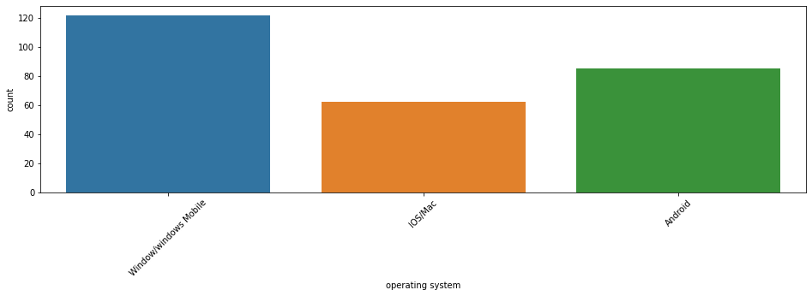
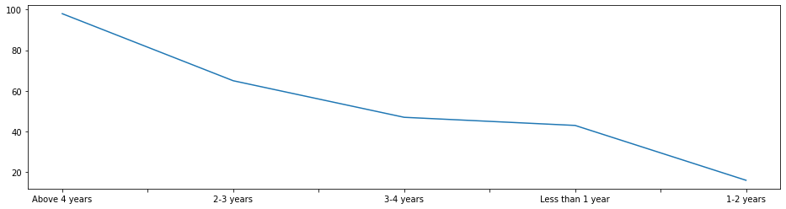
Above 4 years 98
2-3 years 65
3-4 years 47
Less than 1 year 43
1-2 years 16
Name: How Long You are Shopping Online, dtype: int64
Window/windows Mobile 122
Android 85
IOS/Mac 62
Name: operating system, dtype: int64

Slide 31
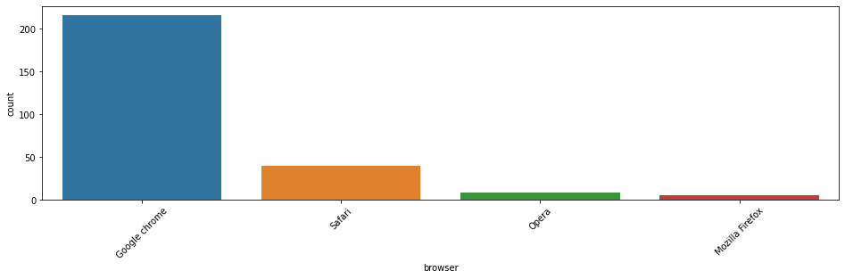
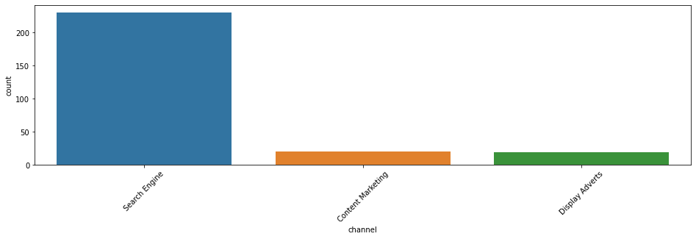
According to analysis, Google Chrome has the highest usage browser for online shopping or we can say that people has lots of faith on Google Chrome for online transactions or shopping. This is the biggest achievement for Google.

Slide 32

Conclusion from Customer Related Information Analysis
1) In people doing online shopping Females are more as compared to Males.
2) People in the age group from 21 to 50 are doing more online shopping as compared to other age groups.
3) Delhi Topped in the city list where a greater number of people doing online shopping.
4) Mostly people are using mobile internet while shopping online.
5) Mostly People are doing online shopping through smartphone.
6) People having windows as operating system(OS) have maximum count.
7) Mostly people are choosing google chrome as browser to access the website
8) People are mostly use search engine to arrive at their favourite online store for the first time.
9) After first visit people are using application or search engine to access website.

Slide 33
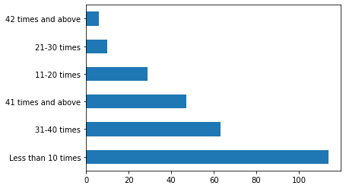
df['How many times in the past 1 year'].value_counts().plot.barh()
Most customers fall under the category of less than 10 orders per year, around the same number fall under the category where no of orders is more than 30
The number of customers who made more than 30 would be our area of interest are they are loyal customers / likely to purchase more

Slide 34
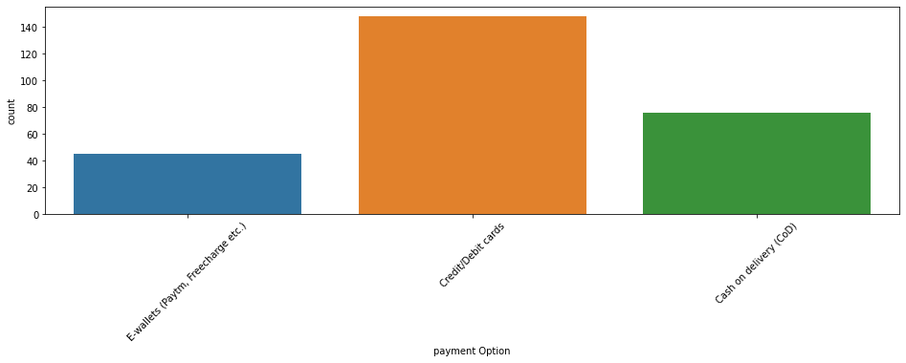
plt.figure(figsize=(16,4)) plt.xticks(rotation=45) print(df['payment Option'].value_counts()) sns.countplot(df['payment Option'])
Mostly people are using credit and debit cards as their preferred payment option.

Slide 35

Analyzing the Feed-Back from Customers

Slide 36
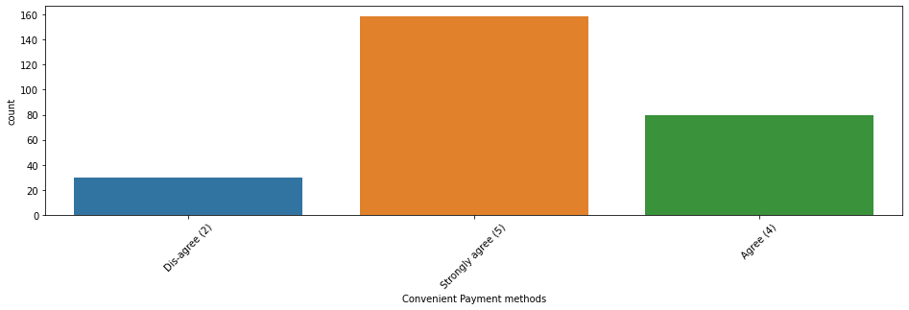
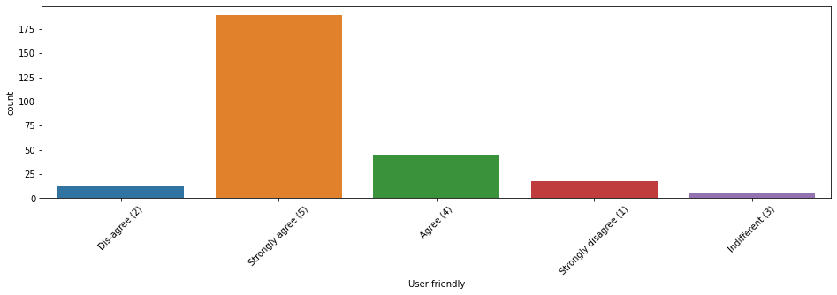
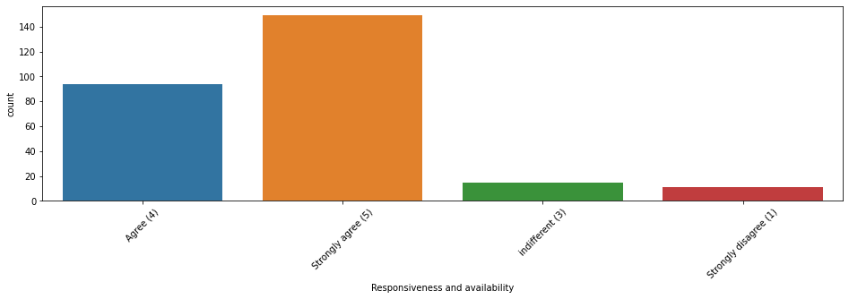
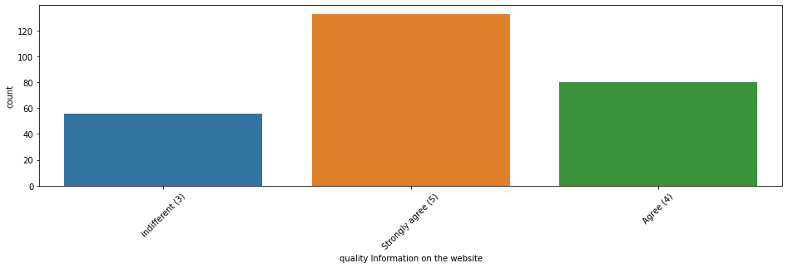

Slide 37
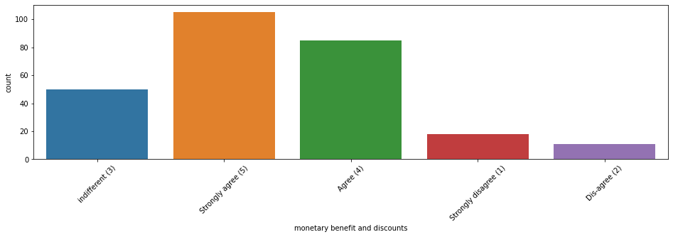
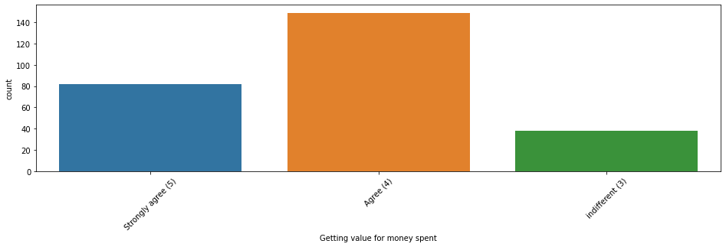
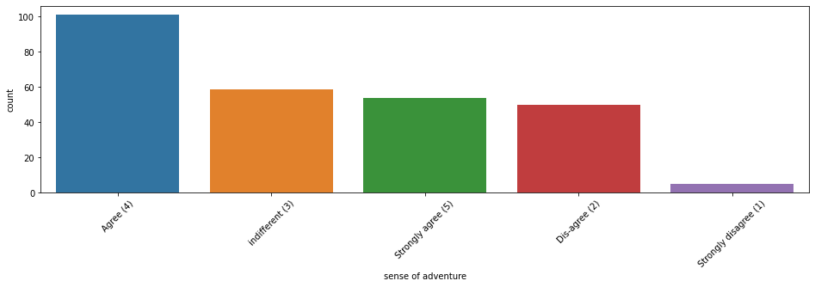
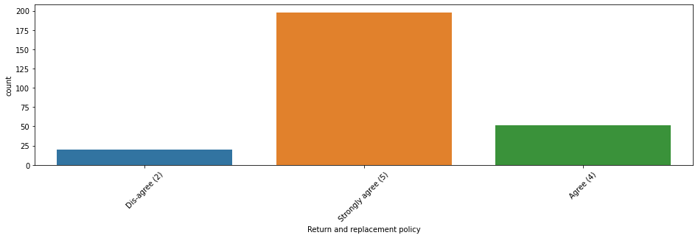

Slide 38
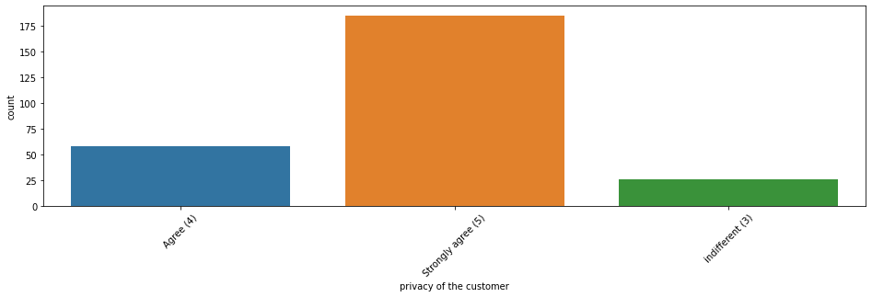
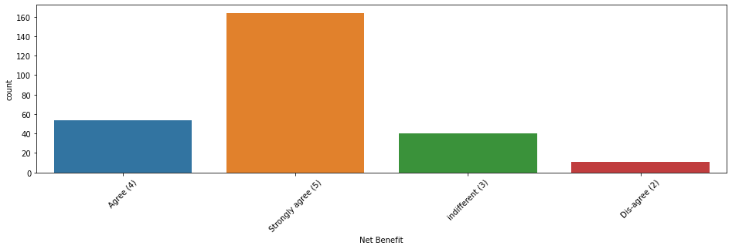
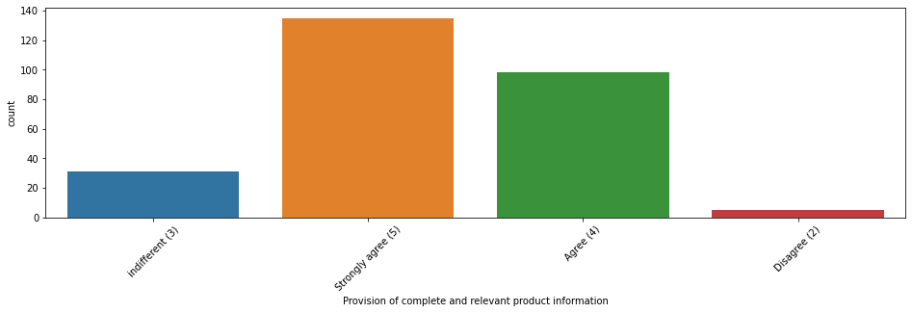
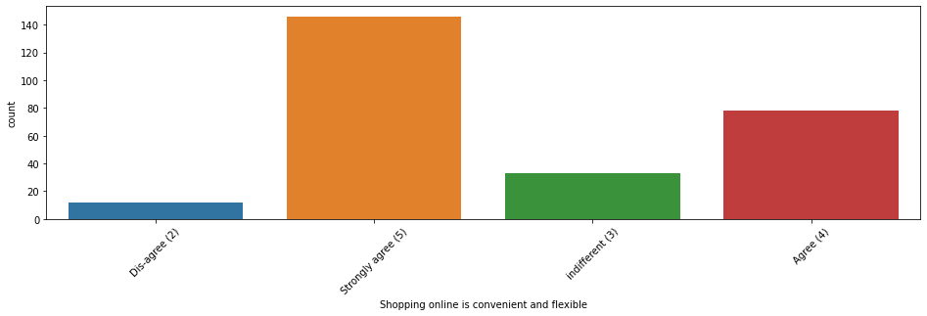

Slide 39
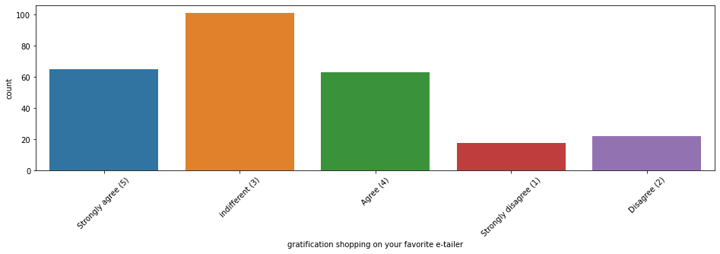



Slide 40




Slide 41

Conclusion from Customer's Feed-Back
People strongly agree that
1 Website has user friendly interface.
2 Payment method Should be convenient.
3 Responsiveness, availability of several communication channels (email, online rep, twitter, phone etc ) is necessary.
4 Online shopping gives monetary benefit and discounts to the customers.
5 Displaying quality Information on the website improves satisfaction of customers.
6 Return and replacement policy of the e-tailer is important for purchase decision.
7 Doing online shopping give them value of money spend.
8 Shopping on the website give them sense of adventure.
9 Being able to guarantee the privacy of the customer
10 User derive satisfaction while shopping on a good quality website or application.
11 Shopping online is convenient and flexible.
12 Gaining access to loyalty programs is a benefit of shopping online.
13 User satisfaction exist when they have trust one website.
14 Their should be provision of complete and relevant product information website.
15 They feel gratification shopping on your favorite e-tailer.
16 The Convenience of patronizing the online retailer.
Users have indifferent opinion that shopping on their preferred e-tailer enhances their social status.
Users have mixed reaction on wheither shopping on website helps them to fulfil certain roles some agree it some are indifferent .

Slide 42

Different Websites or online Shopping Platform Used by Customers

Slide 43

Easy to Use Websites
As per above graph, Majority of the customers are using Amazon.in, Flipkart.com, Paytm.com, Myntra.com, Snapdeal.com as It is Easy to use Websites and as our earlier analysis on device using category shows that Most of the people are using Smartphone and all this online platform has their own mobile application which has lots of features even and Easy to use
Amazon is the choice of among 90% Users, Showing very clear in above Graph

Slide 44

Wild variety of product on offer
Website like Amazon and Flipkart have visual appealing webpage layout and they offer wild variety of products.

Slide 45

Reliability of the website or application
For Reliability of the website or application
61 out of 269 customers choose amazon and
50 out of 269 customers choose amazon and flipkart

Slide 46


Privacy of customers information

Slide 47


Security of customer financial information

Slide 48


Longer delivery period

Slide 49

Change in website/Application design
In Change in website/Application design amazon.in topped the list.

Slide 50


Website is as efficient as before

Slide 51

Which of the Indian online retailer would you recommend to a friend
79 out of 269 choose amazon which tops the list
2nd most is 62 out of 269 choose amazon and flipkart

Slide 52

Conclusion
As in the final countplot in which user were asked which online retailer they would recommend to a friend in this Amazon.in topped the list because it is providing all the features that users want. Website is efficient and it is fast loading , it gives complete , relevant description and information of products . It is reliable and quick to complete the purchase. Amazon give speedy delivery to its customers and there are several payment options available on the website. It provides online assistance through multi channels. Providing good deals on products. Its website have visual appealing webpage layout and they offer wide variety of products and its application is easy to use . lastly the main thing why user recommend it is because of its Trustworthiness and its robust Security in protecting customer financial information and their Privacy information .
These all features make it top the list of recommended online retailer .Providing these features it is retaining its customers.
They are some cons like the amazon website topping the list In Frequent disruption when moving from one page to another this con company should see and improve it to give overall best experience to the users.

